Slide 1
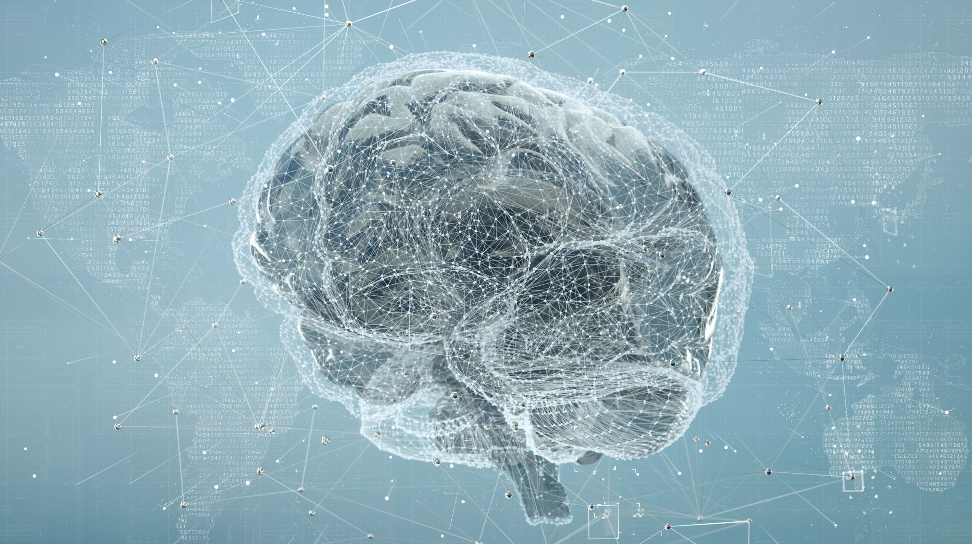
MS in Artificial Intelligence and Computational Drug Discovery And Development
FALL 2024
Notes:
Ms in AI and Computational Drug Discovery and Development

Slide 2
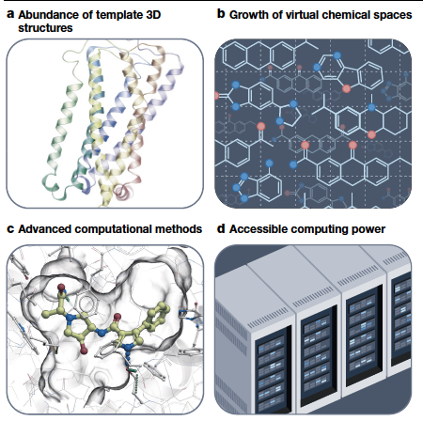
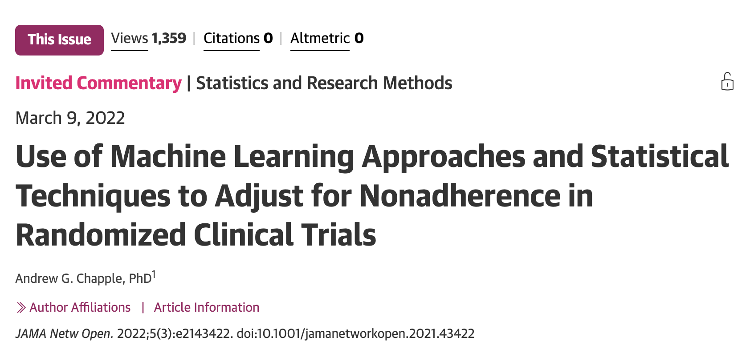
Drug Discovery and Development is Increasingly Computational

Slide 3
Education: A New Master’s Program in Computational Drug Discovery and Development
Job Outlook 2020-2030
22% increase for computer/information research
17% increase for medical scientists
Introductory Material Systems Pharmacology
Systems Biology Computational Chemistry
Databases
Physiologically-based Pharmacokinetic/ Pharmacodynamic Modeling
Population Pharmacokinetic/
Pharmacodynamic Modeling
Pharmacogenomics
Mining and Analysis
of Real-World Evidence

Slide 4
Program of Study
YEAR 1
FALL (13 units) | WINTER (13 units) | SPRING (12 units)
CDD 201 Techniques in Drug Discovery CDD 202 Computational Methods and Tools in Drug Discovery and Development R, Python BIOSTAT 272 | CDD 203 AI/ML and Applications in Drug Discovery and Development CDD 204 Drug Development Regulations and Software Platforms WinNonlin, SimCYP, NONMEM CDD 205 Applications of Pharmacometrics, Systems Pharmacology and Pharmacogenomics | CDD 206 Big Data (RWD/RWE) Mining and Analysis CDD 207 Modeling for Clinical and Translational Pharmacology CDD 223 Emerging Technologies and Topics for Capstone Projects Graduate Studies 214 Ethic Conduct of Science
YEAR 2
SUMMER (3 units) | FALL (3 units)
Capstone Project | Capstone Project

Slide 5
Curriculum Highlights
CDD 201 Techniques in Drug Discovery
CDD 202 Python and R (Numpy, Pandas, PyTorch, Matplotlib) Web Application Development (Flask, Streamlit, Shiny)
CDD 203 AI and ML Supervised, Unsupervised, Semi-supervised, Reinforcement Learning; Sub-fields of ML; Generative AI
CDD 204 Drug Development Regulations and Software Platforms (WinNonlin, SimCYP)
CDD 205 Pharmacometrics, Systems Pharmacology and Pharmacogenomics
CDD 206 Big Data Mining and Analysis (Real-World Data and Real-World Evidence)
CDD 207 Modeling for Clinical Pharmacology
CDD 223 Emerging technologies: Large Language Models (LLM)
Notes:
This course offers an in-depth exploration of Artificial Intelligence (AI) and Machine Learning (ML). Within the realm of ML, participants will gain knowledge of core methods, including supervised, unsupervised, semi-supervised, and reinforcement learning. Furthermore, the curriculum extends to specialized sub-fields and applications of ML, such as deep learning, natural language processing, and computer vision. An additional highlight of the course is its coverage of generative AI, a cutting-edge area that focuses on generating new, synthetic data.

Slide 6
Industry Advisory Board
Kathy Giacomini, PhD, BSPharm​ Dean, School of Pharmacy​ UCSF​ | Atul Butte, MD, PhD ​ Director Bakar Computational Health Sciences Institute ​ | Mark Dresser, PhD ​ Senior Vice President ​ Gilead Sciences ​ | Amita Joshi, PhD, MPharm ​ VP Global Head of Clinical Pharmacology,Genentech ​
Sara Kenkare-Mitra, PharmD, PhD ​ President, Head of RandD ​ Alector ​ | Kourosh Parivar, MPharm​ Consultant​ Top Clin Pharm Consultants LLC ​ | Timothy Nichols, PhD ​ Global Head Pharmacometrics ​ Pfizer ​ | Carl Peck, MD ​ Partner and Founding Chairman ​ NDA Partners ​
Jin Jin, PhD​ Executive Director and Sr. Fellow, Global Head of M&S, and Ophthalmology/Neuroscience Clin Pharm, Genentech​ | Dan Hartman, MD ​ Director, Integrated Development ​ Global Health ​ Bill and Melinda Gates Foundation ​ | William Hanley, PhD ​ Vice President, Global Head of Quantitative Pharmacology ​ Seagen ​ | Sandeep Dutta, PhD ​ Vice President, Clinical Pharm Modeling & Simulations ​ Amgen ​
John Marioni, PhD​ SVP and Head of gRED Computation, Genentech​ | Michael Taylor, PharmD, PhD ​ Vice President, Global Head of RWD, PD Data Science at Roche/Genentech ​ | Xiaoli Wang, PhD​ Head of Clinical Pharmacology and Quantitative Sciences​ Nektar Therapeutics​ | Laszlo Urban, MD PhD ​ Executive Director, Global Head of Preclinical Safety Profiling (PSP) ​ Novartis ​
Russ Altman, MD, PhD ​ Professor, Stanford University ​ | Xingrong Liu, PhD​ Executive Director, Head of DMPK​ Gilead Sciences​ | Sandhya Girish, PhD​ VP Clinical Pharmacology Sciences​ Gilead Sciences​ | Carla Washington, PhD ​ Consultant ​
Jennifer Hibma, PharmD​ Director, Pharmacometrics​ Pfizer​ | Srikumar Sahasranaman, PhD​ SVP, Quantitative Clinical Pharmacology, Prelude Therapeutics​ | Ana Ruiz, PharmD, PhD​ Head of Pharmacometrics​ Gilead Sciences​ | Brian Shoichet, PhD (ex officio)​ Co-Vice Dean, Graduate Education Programs, UCSF​
Juthamas Sukbuntherng, PhD​ Head of Clinical Pharmacology and DMPK, Pharmacyclics​ | Yazdi Pithavala, PhD ​ Executive Director, Clinical Pharmacology, Pfizer ​ | Rada Savic, PhD (ex officio)​ Co-Vice Dean, Graduate Education Programs, UCSF​ | Maya Leabman, Ph.D. ​ Sr. Director Clinical Pharmacology ​ IGM Biosciences​

Slide 7
Career Opportunities
Drug Discovery
Target identification and validation using AI
Modeling for lead compound optimization
Drug Development
PK/PD Modeling
Pharmacometrics Modeling
Bioinformatics
Integrate and analyze biological datasets
Decode genomic sequences and predict protein structures using ML algorithms
Pharmacovigilance
AI-driven monitoring of drug effects
Predict adverse reactions using big data analytics
Translational Medicine
Bridge lab discoveries and patient care
Use computational tools to accelerate clinical trials and personalize treatments.

