Slide 1
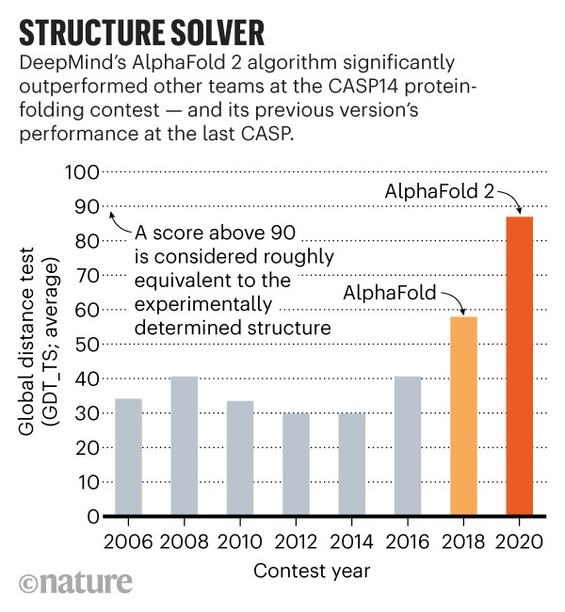
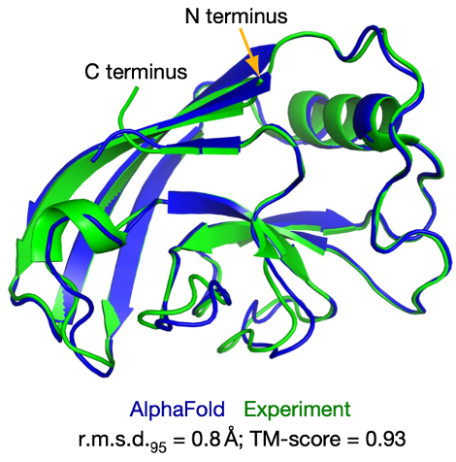
A case study of transformative success: Deep Mind’s AlphaFold2
Unprecedented performance
Transformative capabilities beyond initial goals
Example: Design using GPT-like methods:
“make a novel receptor binding protein”
https://doi.org/10.1038/s41586-021-03819-2
https://doi.org/10.1038/s41586-023-06415-8
Key determinants of success:
Two very large, high information-content datasets:
>100,000 protein structures: coordinates for heavy atoms
>60 Million sequences
Clear benchmark (predict these coordinates) with blind, winnable competition

