Slide 1
We will begin soon
Town Hall

Slide 2
Town Hall
October 2023
Dean’s Updates
Artificial Intelligence
Notes:
This template is intended for presentations that are not specific to the PharmD curriculum.
Do you need the PharmD education template instead? Visit https://pharm.ucsf.edu/present

Slide 3
Update from the Dean
Dean Kathy Giacomini
School Town Hall
October 2023
Notes:
This template is intended for presentations that are not specific to the PharmD curriculum.
Do you need the PharmD education template instead? Visit https://pharm.ucsf.edu/present

Slide 4

Moment of Silence
Image credit: Ngọc Khánh 9211, Wikimedia Commons, CC-BY-SA-4.0
Notes:
As health professionals and health scientists, our primary concern is to do whatever we can to reduce suffering in the world. Many of us are still struggling to comprehend the atrocities that continue to unfold in Israel and Gaza.
Let’s have a moment of silence from all present here today, to honor and remember the victims caught in the middle of these appalling attacks.
By embracing a culture of empathy, we reaffirm our collective commitment to peace and human rights, and reflect the shared values of our diverse community here at UCSF.

Slide 5
Agenda
Dean’s updates
Artificial Intelligence (AI) presentation and panel
Closing

Slide 6



Notes:
This is National Pharmacy Week and American Pharmacists Month so very appropriate for a Town Hall.

Slide 7






Retirements & New Faculty
Recent Retirements
New Faculty
Dean’s Office
Lucia Piriano, curricular affairs assistant
Department of Pharmaceutical Chemistry
Marilyn Stebbins, PharmD, professor and vice chair of clinical innovation
Department of Pharmaceutical Chemistry
Kris Casler, administrative officer
Department of Bioengineering and Therapeutic Sciences
Deanna Kroetz, PhD, chair
Department of Bioengineering and Therapeutic Sciences
Willow Coyote-Maestas, PhD, MS
Department of Clinical Pharmacy
Leslie Floren, PharmD, PhD, MA

Slide 8
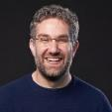
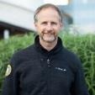
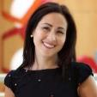
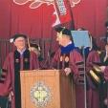
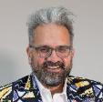

Recognizing Our Faculty, Students, and Staff
Jaime Fraser became the new chair of the Department of Bioengineering and Therapeutic Sciences
Nadav Ahituv appointed director of the Institute for Human Genetics
Nicole Flowers awarded the 2023 Chancellor Award for Exceptional University Service
Jim Wells received an Honorary Doctor of Science from the University of Chicago
Nevan Krogan received the French Legion of Honor award and the Discovery|Innovation|Health Prize from Research!America
Katherine Gruenberg and Stephanie Hsia named 2023 AACP Emerging Teaching Scholars

Slide 9
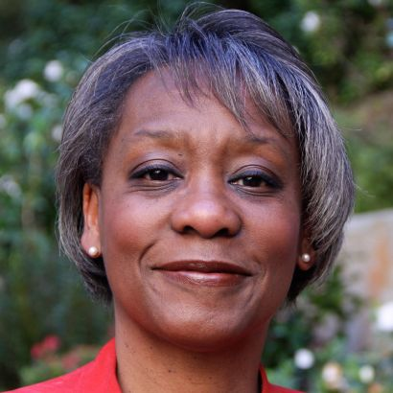
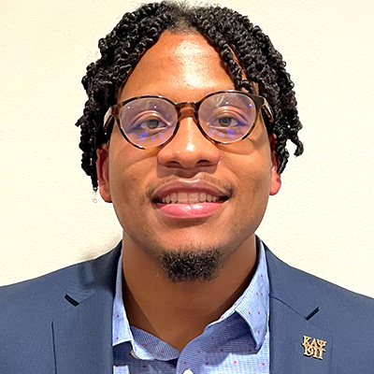
Recognizing Our Faculty, Students, and Staff
2023 Chancellor Awards for Diversity
Chancellor Award for Dr. Martin Luther King, Jr. Leadership
Sharon Youmans, PharmD, MPH
Jaysón Davidson

Slide 10
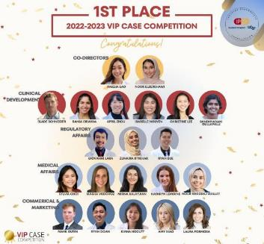
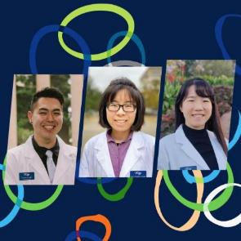
Recognizing Our Students
Value of Industry Pharmacists (VIP) Case Competition
ACCP Clinical Research Challenge

Slide 11
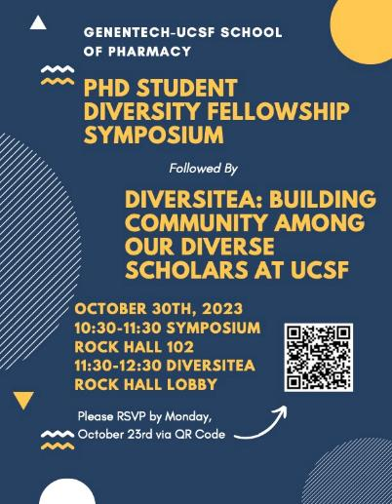
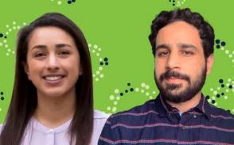
Organized by Ryan Hernandez
Featuring Brenda Melano and Sebastián Cruz-González, our 2023 Genentech fellows

Slide 12


Research
Discovering better health and care delivery with rigor
#1 pharmacy school recipient of National Institutes of Health (NIH) funding in FY22 for 43rd consecutive year
One of these grants include the UCSF-Stanford CERSI, which was renewed for 5 years at up to $10M/year

Slide 13
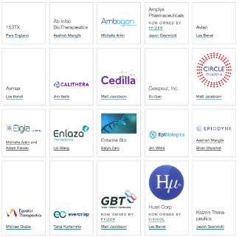
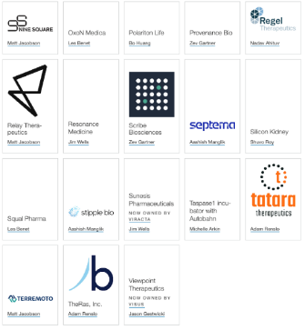
Research: Entrepreneurship
Discovering better health and care delivery with rigor
Developed website to showcase faculty entrepreneurship; 38 companies founded

Slide 14










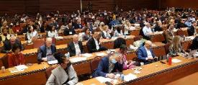
2024 CERSI Innovations in
Regulatory Science Summit
Sunday, January 7, 2024 | 9 am to 5:30 pm at UCSF
In-Person & Virtual Attendance Options
Register at https://cersisummit.com/
Panels
Why is Medical Misinformation Killing Us?
Accelerating CMC Commercialization
FDA Center Directors Forum
FDA Chiefs Chat
Discussion
Case Studies in Variation in Regulatory Decision Making Among Countries: Opportunities for the Future
Debates
Is Direct to Consumer Advertising Good for Patients?
Should Advisory Committees Always Vote?
Kuldev
Notes:
Add time of the event

Slide 15
New Master’s Degree Programs
Developing health leaders and innovators
Artificial Intelligence and Computational
Drug Discovery and Development (AI-CD3)
Regulatory Science and Health Equity
Train the next generation of scientists to apply computer science, data science, statistical analysis, machine learning and other data-driven methods to the discovery and development of new drugs.
Train students in regulatory policies, practices, and decision-making processes while focusing on the importance of addressing health disparities and equitable access to healthcare.

Slide 16
Artificial Intelligence (AI) presentation and panel

