Slide 1
SOP Town Hall
Dean Kathy Giacomini
April 18, 2024

Slide 2
Town Hall Agenda
Time | Topic
12:10 – 12:20 pm | Dean’s Updates (Kathy Giacomini)
12:20 – 12:25 pm | PharmTech Pathway Program (Sharon Youmans)
12:25 – 12:30 pm | UC Merced/UCSF BS to PharmD Pipeline Program (Igor Mitrovic)
12:30 – 12:35 pm | Education Unit Reorganization Update (Conan MacDougall)
12:35 – 12:55 pm | Panel Discussion: How can we increase applications and matriculations into our PharmD program? Joel Gonzales (moderator) Igor Mitrovic Robert Chalkley Tiffany Pon Katherine Gee
12:55 – 1:00 pm | Open Audience Q&A

Slide 3
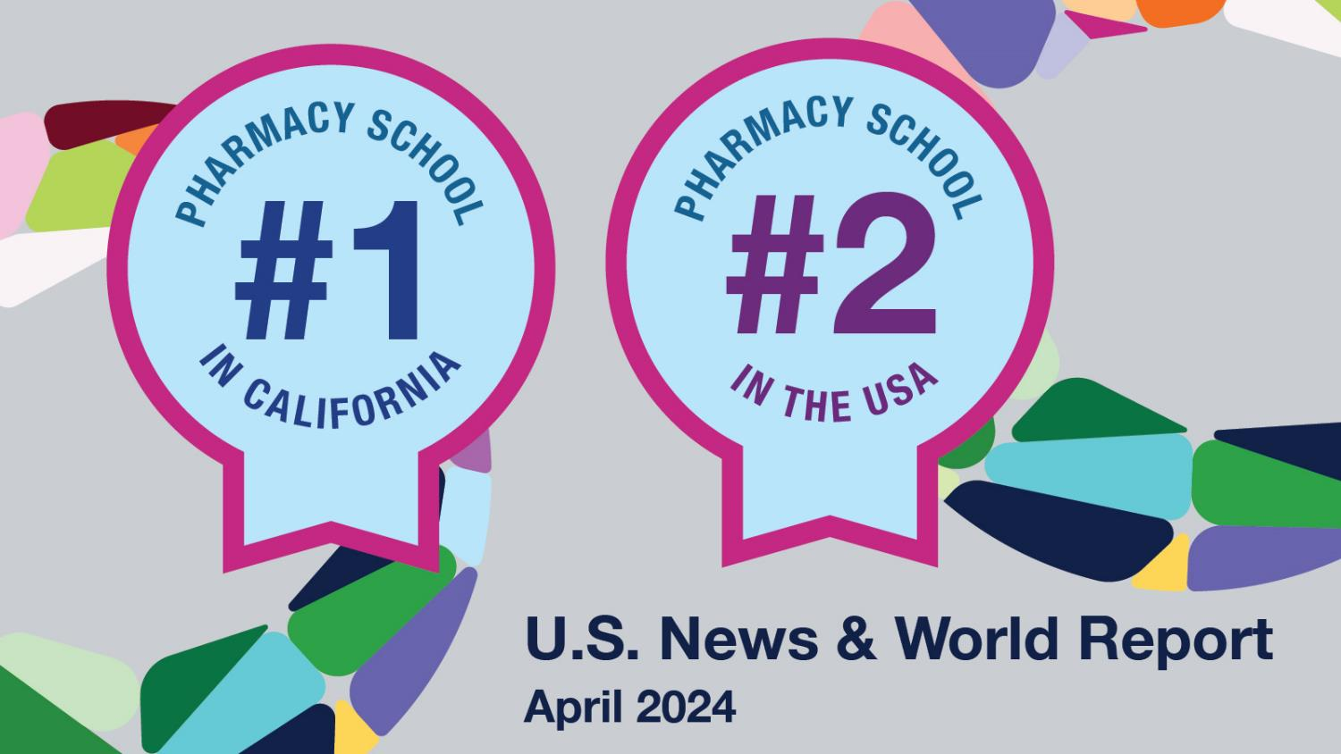

Slide 4
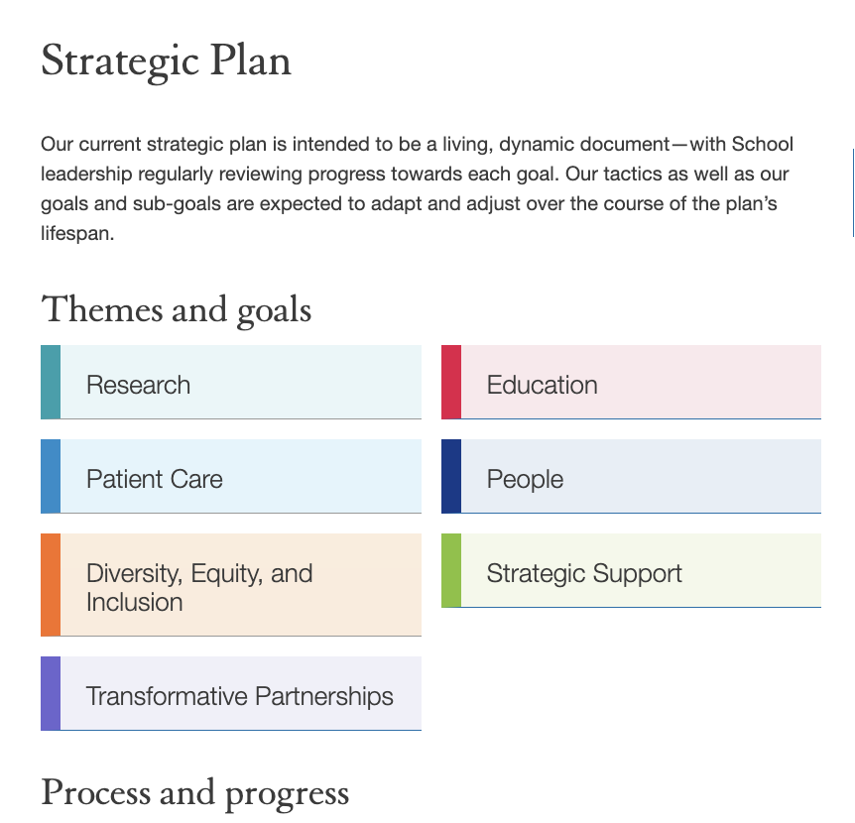

Slide 5
PharmD Admissions
 | 2023 | 2024
Offers Made | 179 | 193
Offers Accepted | 122 | 123
Incoming Class Size | 122 | 123
*4 offers are still pending

Slide 6
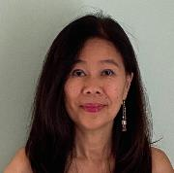
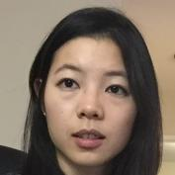
New MS Degree Program in AI-CD3
Now accepting applications for Fall 2024
Application deadline 5/1
Already received 55 applications
Joanne Chun
Michelle Wang
https://pharm.ucsf.edu/aicd3

Slide 7
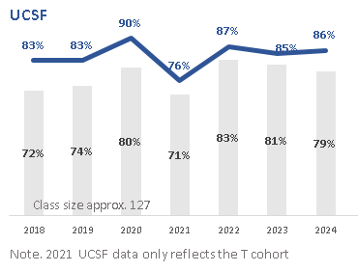
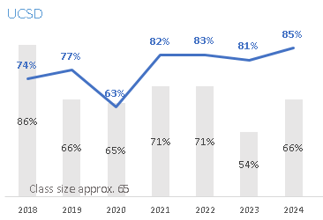
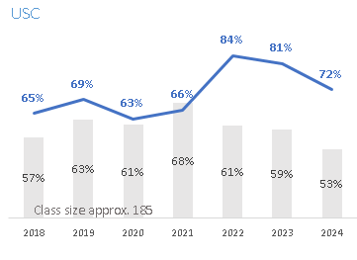
PharmD Residency Match Rates

Slide 8
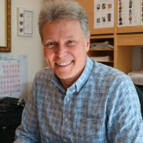
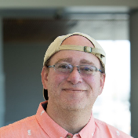
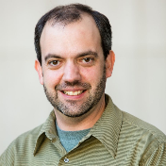
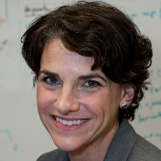
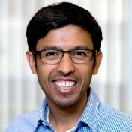
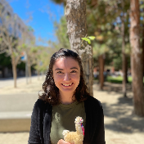
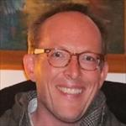
Recognizing Our Faculty
Charles Craik, PhD
received the Andrew Braisted Lectureship (UCSF/UCB)
Brian Shoichet, PhD
was named Clarivate Highly Cited Researcher (2018-2023)
Jason Gestwicki, PhD
received the Emil Thomas Kaiser Award (Protein Society)
Michelle Arkin, PhD
received the Arthur C. Cope Scholar Award, Gordon Hammes Lectureship (ACS)
Aashish Manglik, MD, PhD
received the Byers Award, and was awarded as both Bowes Biomedical Investigator and Clarivate Highly Cited researcher
Katherine Susa, PhD
NIH Early Independence Award
Jeffrey Neitz, PhD
new faculty member in Pharm Chem
Notes:
Charly Craik: Andrew Braisted Lectureship (UCSF/UCB)
Brian Shoichet: Clariviate Highly Cited (2018-2023)
Jason Gestwicki: Emil Thomas Kaiser Award (Protein Society)
Michelle Arkin: Cope Scholar (American Chemical Society), Gordon Hammes Lectureship (American Chemical Society)
Aashish Manglik: Byers Award, Bowes Biomedical Investigator, Clariviate Highly Cited
Katherine Susa: NIH Early Independence Award

Slide 9
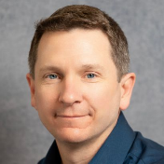
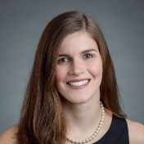
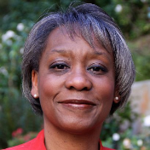
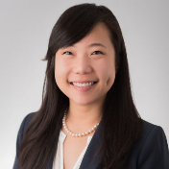
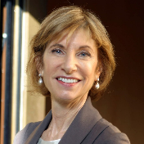
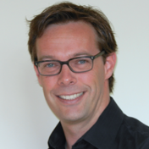
Recognizing Our Faculty
Conan MacDougall, PharmD, MAS
received the Academic Senate Distinction in Teaching, 2024
Amelia Deitchman, PharmD, PhD
received the Darrell Abernethy Early Stage Investigator Award, 2024
Sharon Youmans, PharmD, MPH
received the American Society of Health-System Pharmacists- Association of Black Health System Pharmacists Joint Leadership Award, 2023
Crystal Zhou, PharmD
received the American College of Clinical Pharmacy Cardiology PRN Clinical Practice Award, 2023
Kathryn Phillips, PhD
honored by the top-most cited 100,000 scientists list for 2022, Elsevier Data Repository; Brocher Foundation Scholar in Residence
Jeroen Jansen, PhD
honored by the top-most cited 100,000 scientists list for 2022, Elsevier Data Repository
Notes:
From Jen Cocohoba (ClinPharm)
Conan MacDougall, co-vice dean for PharmD education received the Academic Senate Distinction in Teaching (2024)
Amelia Deitchman, based out of the UCSF Drug Research Unit (DRU), received the Darrell Abernethy Early Stage Investigator Award from the American Society for Clinical Pharmacology and Therapeutics (ASCPT)
Executive Vice Dean Sharon Youmans, American Society of Health-System Pharmacists- Association of Black Health System Pharmacists Joint Leadership Award (2023)
Crystal Zhou Cardiology PRN Clinical Practice Award from the American College of Clinical Pharmacy, (ACCP), 2023
Kathryn Phillips, PhD, and Jeroen Jansen, PhD, honored by the top-most cited 100,000 scientists” list for 2022, Elsevier Data Repository

Slide 10
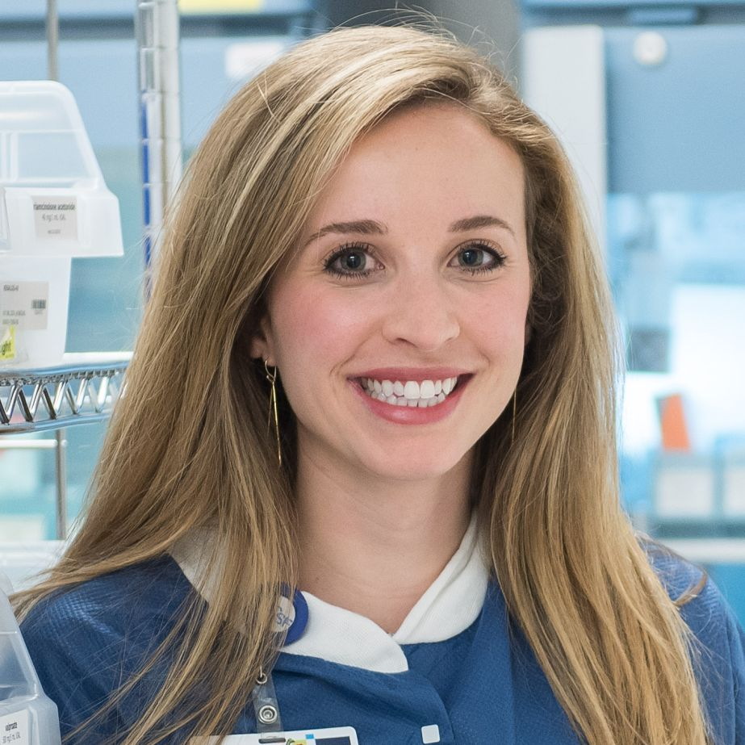
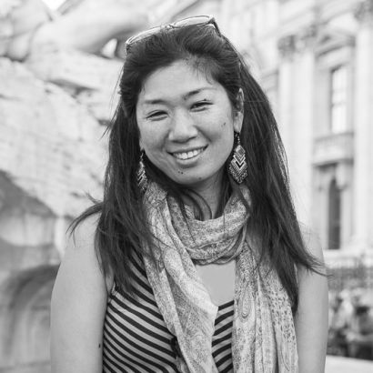
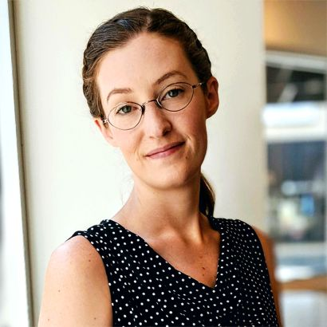
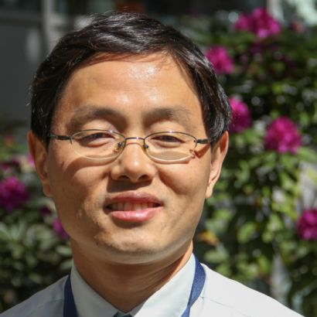
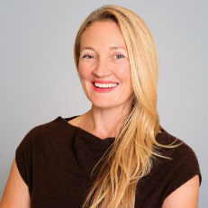
Recognizing Our Faculty and Staff
American Association of Colleges of Pharmacy (AACP) Award for Excellence in Assessment
in honor of collaborative curricular mapping work
Preclinical Design and Clinical Translation of TB Regimens (PReDicTR) Consortium
$30.8M grant from the National Institute of Allergy and Infectious Diseases (NIAID)
Katherine Gruenberg, PharmD, MA
Yukiko Watanabe, PhD
Laura Armstrong, PhD
Jaekyu Shin, PharmD, MS
Rada Savic, PhD
Notes:
Selected April 2024 by the American Association of Colleges of Pharmacy, this award recognizes a program for a novel or innovative approach to improving curricula and student learning, and acknowledges an assessment initiative or project that uses systematic collection, review, and use of information to improve the PharmD program
Rada Savic, PhD, co-vice dean of Graduate Pharmacy Education Programs and a professor in the Dept of Bioengineering and Therapeutic Sciences (BTS), has been awarded a $30.8M grant over five years from the National Institute of Allergy and Infectious Diseases (NIAID) at the National Institutes of Health (NIH). The UM1 cooperative agreement will establish a consortium of TB preclinical and clinical experts in an unprecedented level of data and knowledge integration, to research the most effective treatment options for future clinical testing, with pediatric populations as a key focus.

Slide 11
Recognizing Our Staff
New staff hires since October 2023
Name | Department | Title
Holly Ly, PharmD | BTS | CERSI Education Coordinator
Rebecca Niznak | BTS | Executive Business Administrator
Kyle Shun | BTS | Staff Research Associate
Jimmy Sit | BTS | Post Award Analyst
Emma Gunderson | Clin Pharm | Lab Supervisor
Ruben Vargas | Clin Pharm | Research Data Analyst
Sahru Keiser | Dean’s Office | Project Manager
Name | Department | Title
Nourhan Mesbah | Dean’s Office | Program Analyst
Racha Kabbani | Poison Control | Toxicology Mgmt. Specialist
Thuy Le | Poison Control | Contracts & Grants Specialist
Kim Vo Ostrikova | Poison Control | Toxicology Mgmt. Specialist
Holli Deval | QBI | Assistant Lab Manager
Zelda Love | QBI | Associate Director, Grants Manager
Ali Sasan | QBI | Financial Services Analyst
Swathi Sukumar | QBI | Operations Assistant

Slide 12
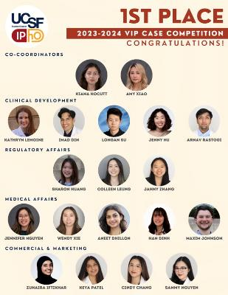
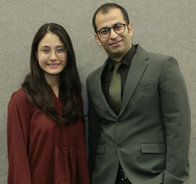
Recognizing Our Students
28th annual American Society of Health-System Pharmacists (ASHP) Clinical Skills Competition FIRST PLACE among 133 pharmacy school teams
Industry Pharmacists Organization's (IPhO) Value of Industry Pharmacists (VIP) Case Competition FIRST PLACE against 66 pharmacy school teams
Linda Cheng and Siavash Panahi Class of 2024
Notes:
A pair of UCSF PharmD students brought home the win in this national interactive competition that challenges student pharmacists to analyze complex patient case scenarios and make treatment recommendations for them. This is the third time a team from the School has won the clinical skills title.
The VIP Case Competition was a 6-month drug development competition simulating the process from bench to bedside for a mock drug candidate. At UCSF, this competition is conducted alongside a student elective course, taught by Kiana Hocutt and Amy Xiao with Dr. Leslie Floren as faculty advisor. UCSF’s team beat 66 pharmacy school teams, and won for the second year in a row!

Slide 13
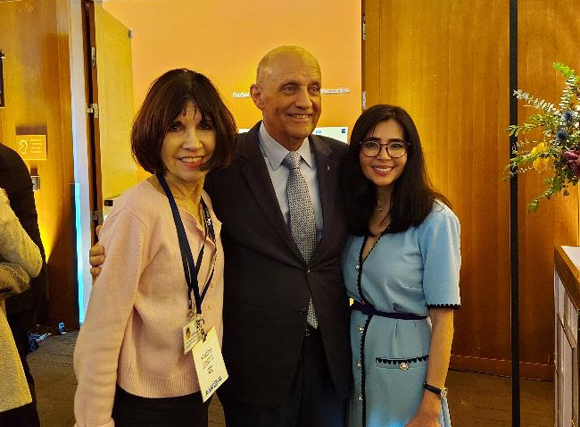
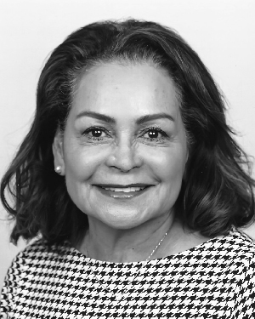
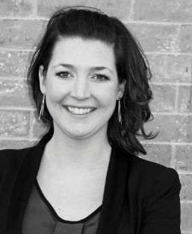
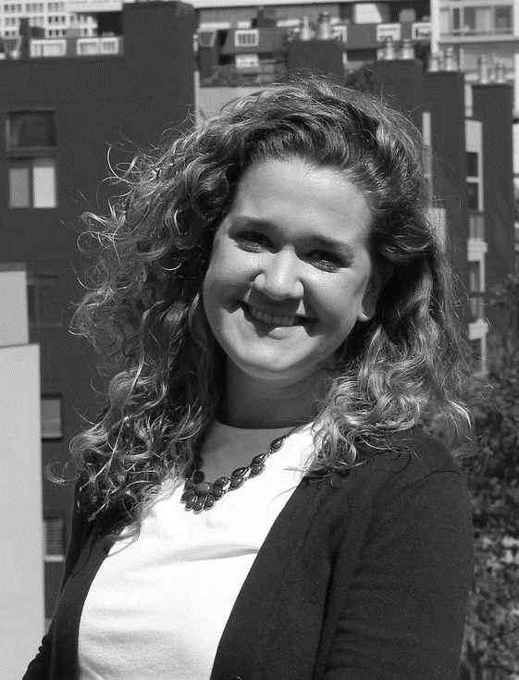
UCSF Alumni Weekend 2024
Special Thanks To:
Lucy Saldana, PharmD
LeeAnn Mutchler
Brigid Riley

Slide 14
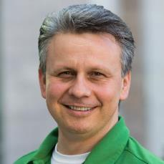
New PharmD Pathway Programs
Goal: Increase Hispanic representation in pharmacy and reduce health disparities
PharmTech to PharmD Pathway Program
UC Merced-UCSF BS to PharmD Pathway Program

Slide 15
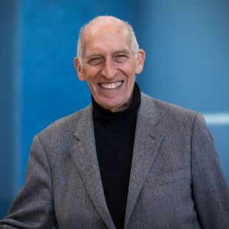
In Tribute to Excellence: The Pioneering Contributions of Les Benet A Symposium in Honor of Leslie Z. Benet, PhD
Friday, May 17, 2024
8:30am to 6:30pm
Genentech Hall Auditorium
RSVP Today!
https://pharm.ucsf.edu/benet-event
15

Slide 16
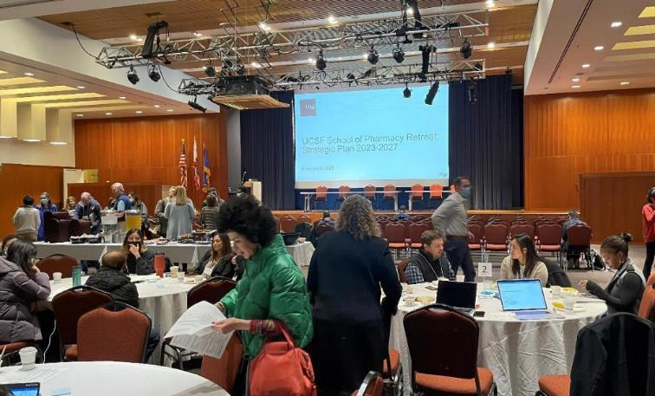
2024 School of Pharmacy Retreat
Tuesday, September 16, 2024
Robertson Auditorium
Mission Bay Conference Center
Agenda
Strategic Plan Updates (breakouts)
Artificial Intelligence (AI)
Keynote by Sam Hawgood
Lightning talks on AI in research, clinical care, and education
Incorporating AI into the strategic plan (breakouts)
Student poster session and reception
16

Slide 17
Presentations on New PharmD Pipeline Programs

Slide 18
Introduction to PharmTech Pipeline Program

Slide 19
UC Merced to UCSF SoP Pipeline
Igor Mitrovic

Slide 20
UC Merced to UCSF Pipeline
UCM-UCSF BS/PharmD Program
Recruitment of 5 students from the SJV (with UCM)
3-years at UCM taking classes that satisfy our PharmD prerequisites
Students will matriculate to UCSF PharmD program if they meet/maintain program requirements while at Merced before attaining BS
First year courses (e.g. Foundations 1 and CV) units count toward BS degree at UCM
At the end of the year 1 at UCSF, awarded BS degree at UCM
APPEs (Clinical rotations) in UCSF SoP Fresno Program
Regular PharmD Program Pipeline
Develop active recruitment effort together with UCM Faculty
Develop expedited admissions for qualified UCM students

Slide 21
UCM-UCSF BS-PharmD Program Funding
California Health Care Foundation is funding the first three years!
Total of $ 426,000
$100,000/year to UC Merced via subaward
CHCF to support us in finding long-term program support

Slide 22
UCM-UCSF BS-PharmD People
UC Merced:
Administrative/Faculty Lead: Ryan Baxter
Program Administrator (part time): TBA
Faculty Committee: 3 TBA
UCSF SoP:
Faculty Lead: Igor Mitrovic,
Program Proposal Writer: Joanne Chun
Program Administrator (part time): Anne Sufka
Faculty Committee: 2 TBA

Slide 23
Major Milestones
Hire administrators and appoint faculty program committee at UCM and UCSF | April - June 2024
Develop and submit comprehensive dual degree program proposal to Academic Senate at UCSF and UC Merced | December 1 2024
Obtain full approval for dual degree program from UC Regents/advertise both dual degree program and UCSF PharmD to UC Merced undergraduates | July/August 2025
Accept applications for the new dual degree program and select first five program participants. | December 2025
Launch new dual degree program with inaugural class of five students at UC Merced. | January 2026
Develop joint activities with the SJV PRIME+ program, including interprofessional experiences, for dual degree program participants | February 2026
Start the first class of students at UCM | September 2026

Slide 24
Education Unit Reorg Update
Conan MacDougall

Slide 25
PharmD Education Unit Reorganization: Goals
Organizational structure that reflects unit functions
Addresses emerging needs
Assessment and accreditation
Student professional development
Strengthens faculty and staff administrative partnerships

Slide 26
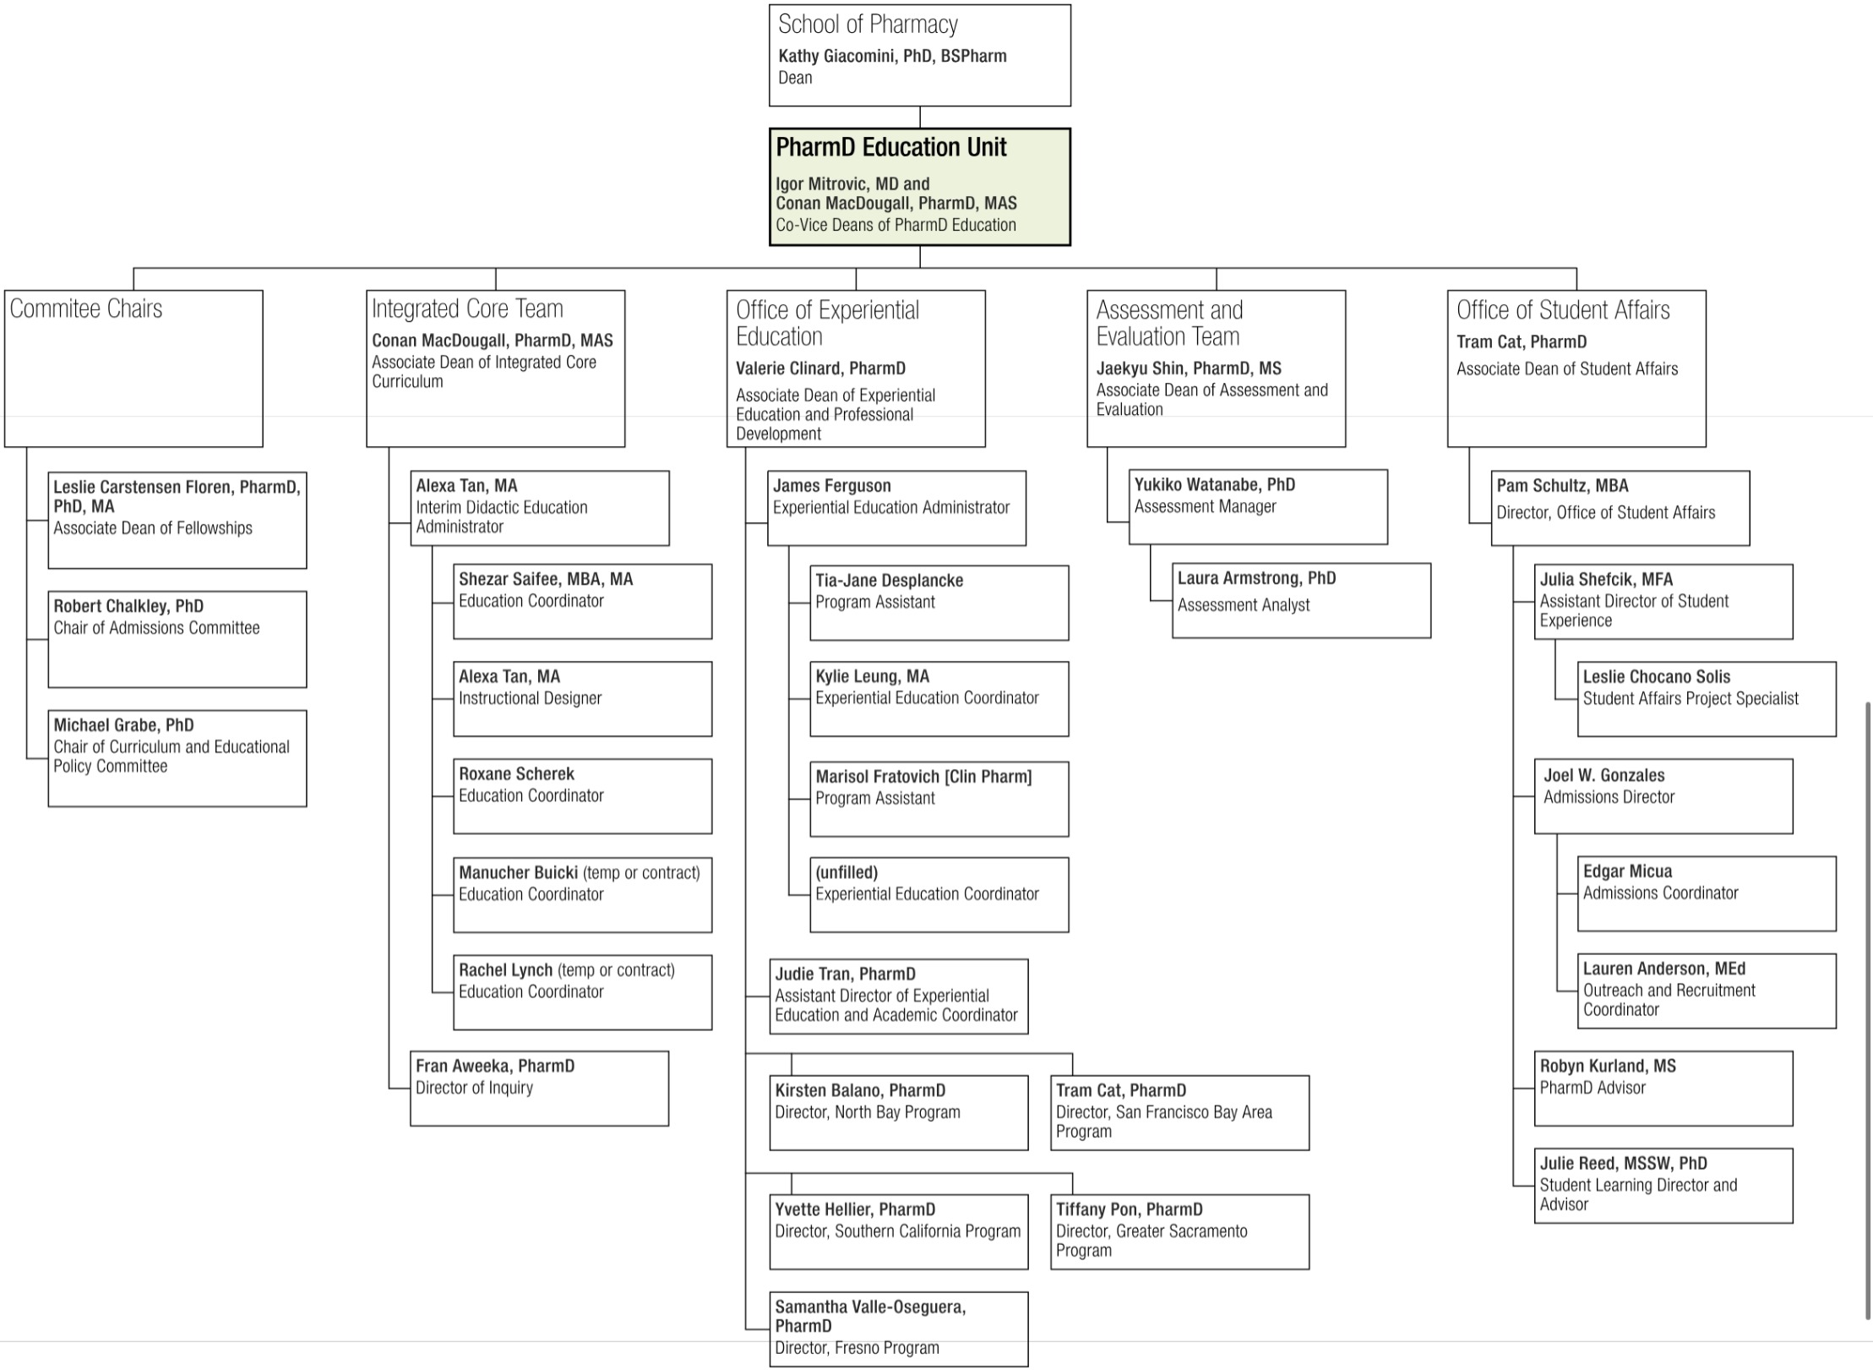

Slide 27
How can we increase applications and matriculations into our PharmD program?
Joel Gonzales

Slide 28
PharmD Outreach/Recruitment
Traditional methods completely covered:
Pre-Pharmacy student organizations
Undergraduate career/pre-health fairs/events
Pre-Pharmacy symposiums (NoCal/SoCal)
Major presence in California (ex. Admissions Panels)
High-touch interaction with prospective students
Monthly virtual Information Sessions / Student Panels

Slide 29
PharmD Outreach/Recruitment
How do we tap into untapped/unique student populations?
How do we engage a larger group of UCSF SOP stakeholders to recruit (ex. students/faculty)?
How do we re-define what a PharmD is (or can do)?

Slide 30
Panelists
Igor Mitrovic, Co-Vice Dean of PharmD Education
Robert Chalkley, Associate Adjunct Professor
Tiffany Pon, Associate Professor
Katherine Gee, SOP student

