Slide 1
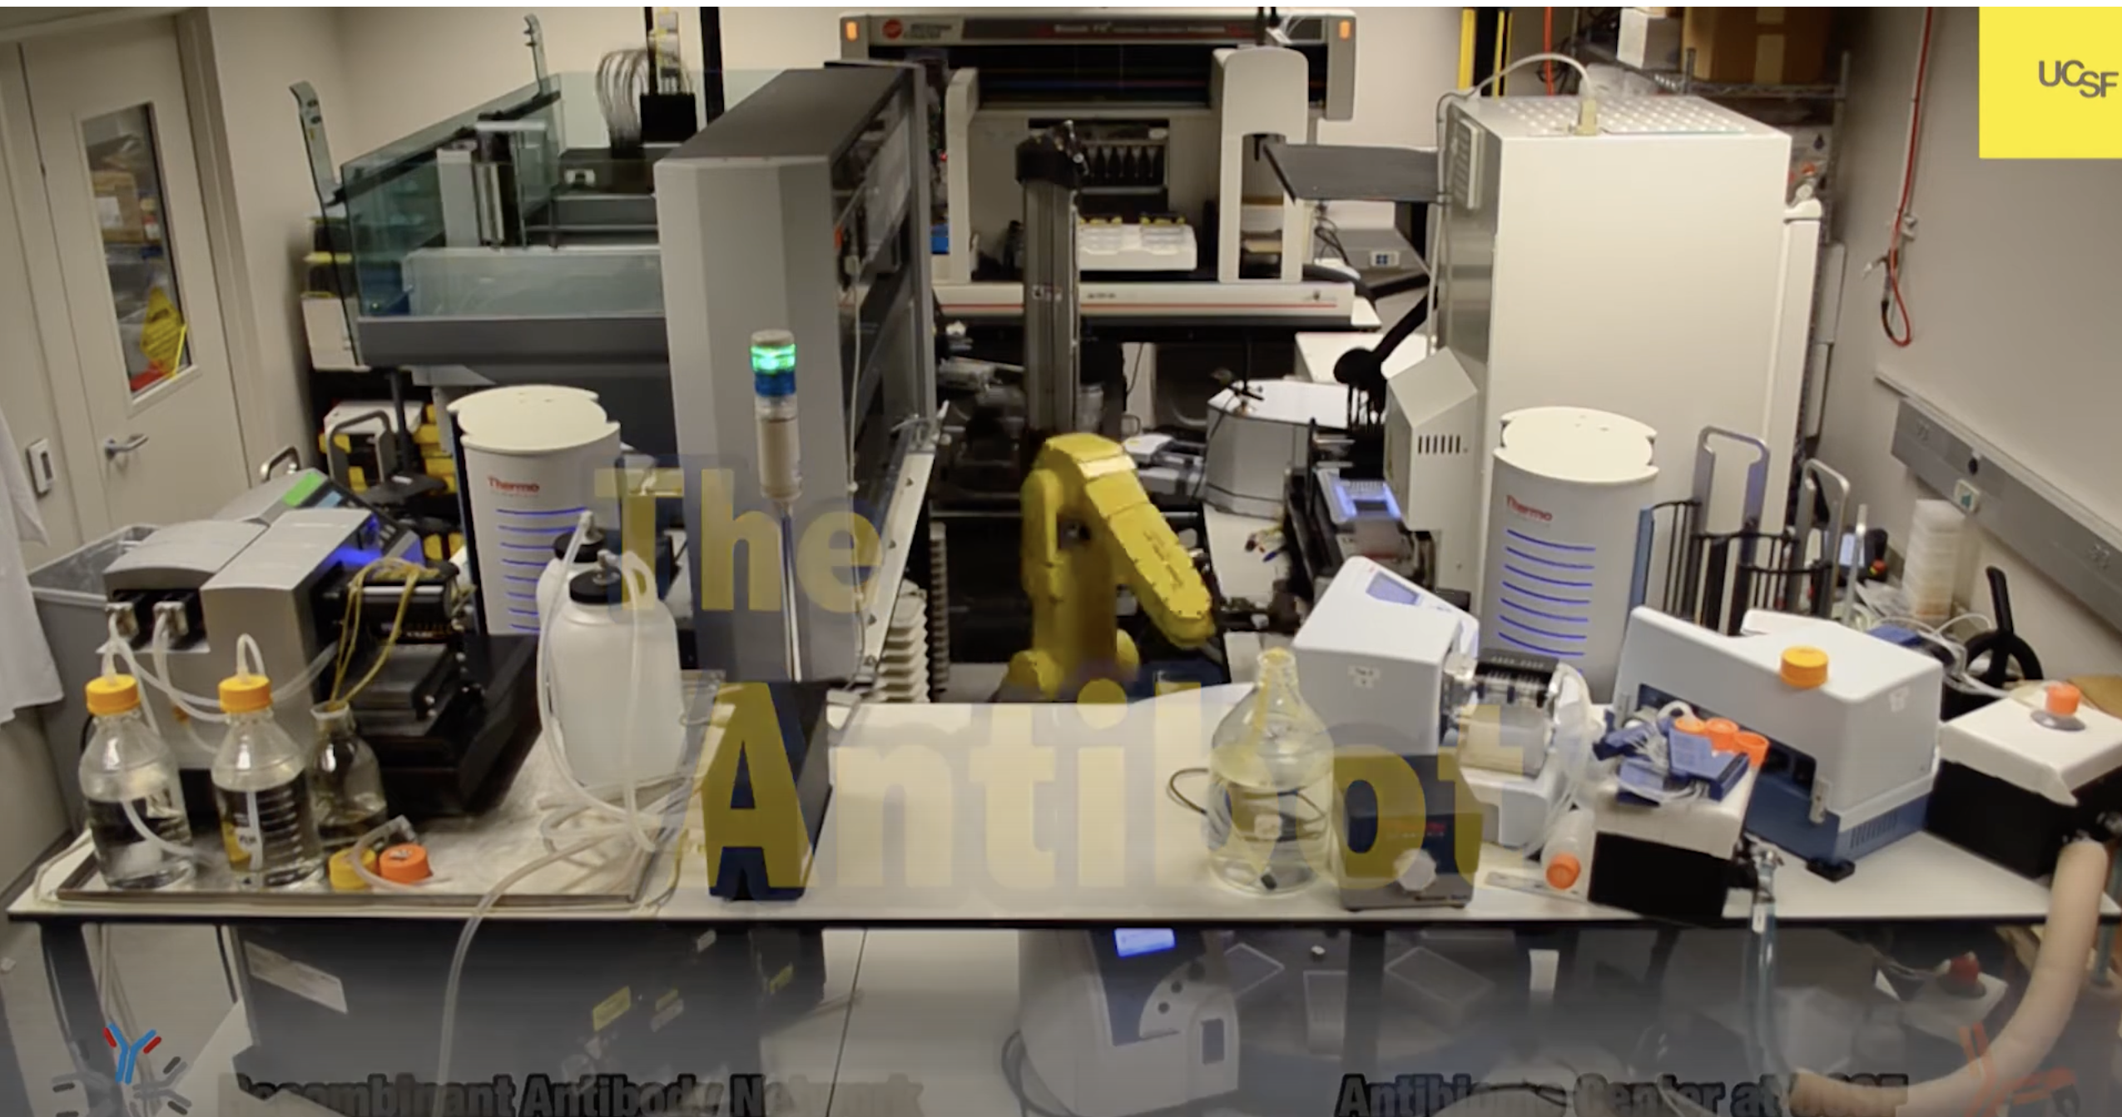
SOP Strategic Plan Update – RESEARCH
Co-Leads: Robin Corelli and Tanja Kortemme
Group Members: Steve Altschuler, Bill DeGrado, Bo Huang, Akinyemi Oni-Orisan, Kathryn, Phillips, Catera Wilder
Goals:
1.1 Develop the mechanistic understanding, technology, and translational strategies to find treatments for all human diseases
1.2 Optimize health and care delivery through clinical and health services research affecting medications, tests, devices and delivery innovations
1.3 Harness and conduct research that transforms PharmD education
1.4 Enable and reward entrepreneurship of our faculty, staff, and trainees, who found and collaborate with companies and engage in other strategic partnerships
1.5 Harness innovations in artificial intelligence to accelerate and integrate discovery and translational research by expanding existing strengths and through new faculty recruitment
Highlighted Subgoals:
1.1.1 Support and create expert-led technology centers (instrumentation and people) to enhance methodological innovations and accelerate groundbreaking research.
1.1.2 Build and grow collaborative teams to work on cross-cutting challenges that bridge the gap from atoms to organisms and populations.
1.2.1 Create and support collaborations that assess the clinical effectiveness, preferences, cost-effectiveness, budget implications, and health equity effects of health technologies.
1.3.1 Create a collaborative educational research hub that provides funding, support, and development for conducting and disseminating educational research.
1.3.2 Apply theory, analysis, and experimentation to solve challenges in health professions education.
1.4.1 Create an environment that supports entrepreneurship, utilizing resources with SOP and QBI, and developing new external partnerships with a resulting financial benefit to SOP, departments, laboratories and inventors.
1.5.1 Expanding strengths in AI through new faculty recruitment.
Challenges:
Decreasing federal funding for curiosity-driven discovery science
Long-term support for technology centers and experts
Speed of AI developments in drug discovery and clinical sciences, requiring large-scale data, computational resources, and AI expertise
Limited funding opportunities for educational research
Future Directions:
Increase opportunities at the interface of academic science and entrepreneurship
Faculty recruitment at collaborative intersections and artificial intelligence
Enhance the faculty pipeline through the creation of a PharmD academic fellowship program
Expand and promote the PharmD-PhD dual degree program
Accomplishments to Date
Subgoal – 1.1.1 technology
Small molecule Discovery Center – Charles Hart, new director
NMR structure determination and drug discovery accelerated by new AI methods
Subgoal – 1.1.2 collaborations
DARPA grant for anesthesia innovation (Shoichet, Sello, Manglik, Irwin, Basbaum, Hibbs)
Center for Collaborative Innovation (CCI): collaboration event, MAKK grants (Guo)
QBI collaborative opportunities: multiple RFAs throughout the year, including QCRG (infectious disease), UCD (drug/drug target discovery), CCMI (cancer)
Subgoal – 1.2.1 health and care delivery
Preclinical design and clinical translation of TB regimens (PReDicTR) Consortium (Savic)
Natl Academy Med Committee: Strategies to align investments in innovations for therapeutic disease burden and unmet needs (Phillips)
Health equity study that determined the clinical validity of understudied candidate functional SLCO1B1 variants common in understudied groups. (Oni-Orisan and collaborators at UCSF, Stanford and Kaiser)
Subgoal – 1.3.1 conduct and disseminate education research
Multiple presentations at AACP, AERA, AMME, CSHP; received AACP Assessment and Emerging Teaching Scholar Awards; multiple funded CFE Innovations for Education grants (Armstrong, Cat, Chun, Clinard, Floren, Gruenberg, Hsia, MacDougall, Pon, Shin, Takhar, Watanabe)
Subgoal – 1.3.2 experimentation to solve challenges in health professions education
Developed and launched a 2-year Health Equity Curriculum in 2024 with sustainably funded near-peer student instructor internships (Hsia, Tuan)
Subgoal – 1.4.1 entrepreneurship
Rezo: integrated mapping of disease networks for precision therapeutics (Krogan, Jura, Shokat, Bandyopadhyay)
Subgoal – 1.5 AI
New BTS faculty hire expands strength in genomics and AI (Calderon)
Need to output at 200%

