Slide 1
School Town Hall
Recent Accomplishments
Leadership Team
Leadership Spotlight: Educational Opportunities
November 16, 2022

Slide 2
Holiday Release Guideline
1 pm release on select holidays
Offices close and most staff stop work at 1 pm
Some exceptions due to shifts and coverage
Check with your supervisor
Managers: Contact Alesia Woods with questions
Holiday | 1pm release | Holiday dates
Thanksgiving | Wed 11/23 | 11/24–11/25
Christmas | Thu 12/22 | 12/23, 12/26
New Year’s | Thu 12/29 | 12/30, 1/2
Memorial Day | Fri 5/26 | 5/29
Independence Day | Mon 7/3 | 7/4
Labor Day | Fri 9/1 | 9/4

Slide 3
Town Hall Agenda
Recent Accomplishments
New Leadership Team
Leadership Spotlight: Education

Slide 4
Recent Accomplishments
Hosted reception at ACCP 2022
Created new student scholarships for incoming students
Established new interactions with Genentech
Improved PharmD website (pharmd.ucsf.edu)
Initiated strategic planning process
Appointed new school leadership team

Slide 5
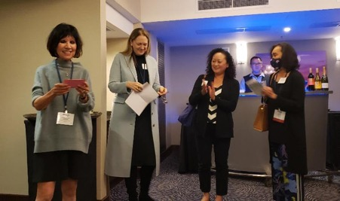
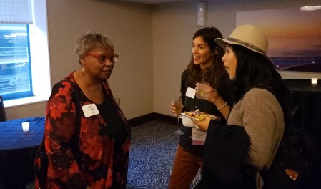
ACCP Annual Meeting 2022
American College of Clinical Pharmacy
9 Poster Presentations
1 Invited Presentation – Betty Dong
  Best Practices for Pharmacist-Driven HIV Prevention Services
1 Award Recipient – David Quan
  Elected as 1 of 35 Fellows of the American College of Clinical Pharmacy
UCSF Reception
  40 attendees: faculty, staff, alumni, trainees, and guests
Come to the UCSF Reception at upcoming meetings:
CSHP Seminar in Anaheim – Friday, November 11 from 5-7 pm
ASHP Midyear Clinical Meeting in Las Vegas – Tuesday, December 6

Slide 6
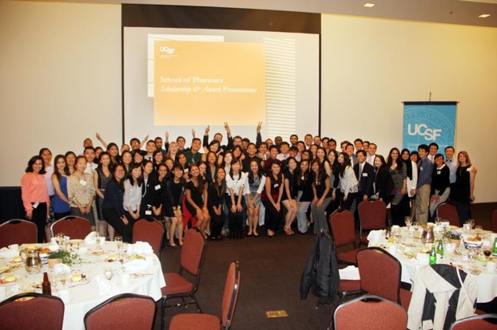
New Scholarships
for Incoming PharmD Students
$500,000 to fund endowment for incoming student fellowships
Four $5,000 scholarships (starting with 2023 admissions)
NEW
NEW

Slide 7


New Interactions
with Genentech
Three APPE rotation slots for UCSF PharmD students (starting in 2023)
Genentech-UCSF School of Pharmacy PhD Student Diversity Fellowship
  Covers CCB, BMI, Biophysics, and PSPG graduate programs
  Five-year agreement; funds two PhD or PharmD/PhD students/year who have advanced to candidacy
  Fellows will also complete a summer rotation at Genentech
NEW
NEW

Slide 8
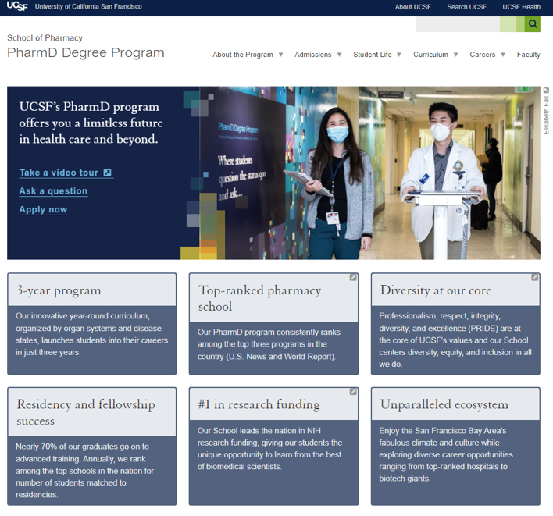
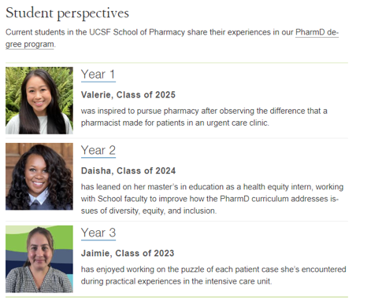
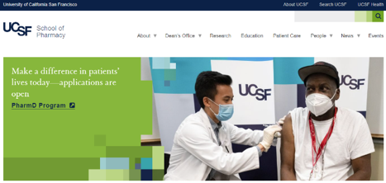
PharmD Website Improvements
NEW
NEW

Slide 9
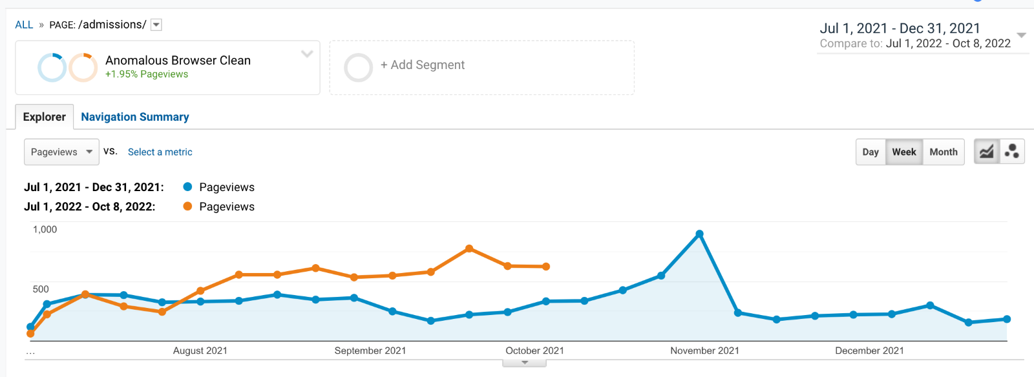
Website Traffic Data

Slide 10
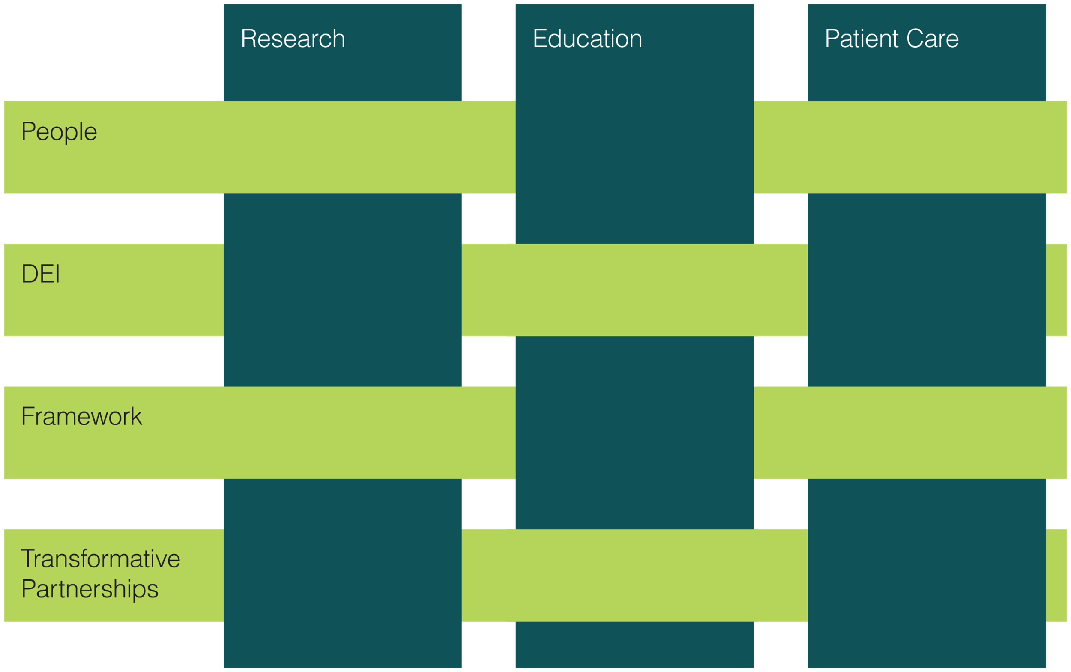
Strategic Plan Themes
Research
Education
Patient Care
People
Diversity, Equity, and Inclusion (DEI)
Framework
Transformative Partnerships

Slide 11
Leadership Team

Slide 12
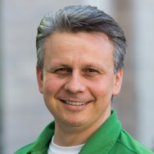
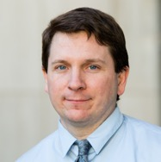
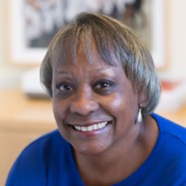
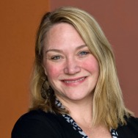
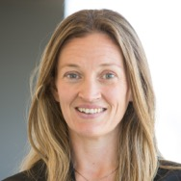
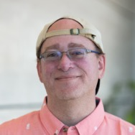
Educational Opportunities
Igor Mitrovic, MD, and
Conan MacDougall, PharmD, MAS
Co-Vice Deans of PharmD Education
Sharon L. Youmans, PharmD, MPH
Executive Vice Dean
Leslie Floren, PharmD, MA
Associate Dean of Fellowships
Rada Savic, PhD, and Brian Shoichet, PhD
Co-Vice Deans of Graduate Pharmacy Education Programs

Slide 13
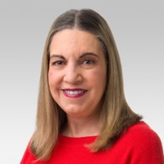
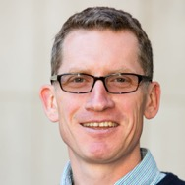
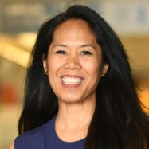
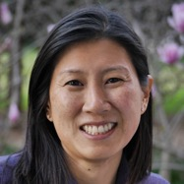
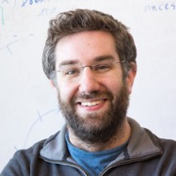
Transformative Partnerships
Desi Kotis, PharmD
Vice Dean of Clinical Affairs
Adam Renslo, PhD
Vice Dean of Entrepreneurship and Industry Relations
Jennifer Cocohoba, PharmD, MAS and
Katherine Yang, PharmD
Co-Vice Deans of Clinical Innovation and Entrepreneurship
James Fraser, PhD
Vice Dean of Research

Slide 14
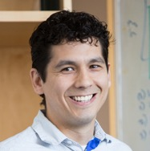
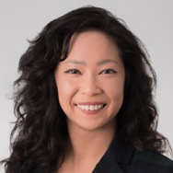
Diversity, Equity, and Inclusion
Ryan Hernandez, PhD and Stephanie Hsia, PharmD, MEd
Co-Vice Deans of Diversity, Equity and Inclusion
Sharon L. Youmans, PharmD, MPH
Executive Vice Dean

Slide 15
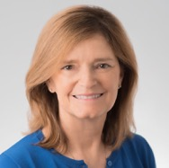
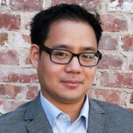
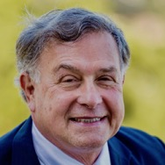
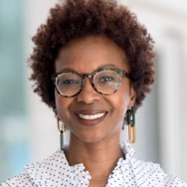
Faculty and Staff Engagement
Robin Corelli, PharmD
Vice Dean of Academic Affairs
Lawrence Lin, PhD
Vice Dean and Chief of Staff
Frank Szoka, PhD
Director of Faculty Engagement and Awards
Alesia Woods
Vice Dean of Administration and Finance

Slide 16
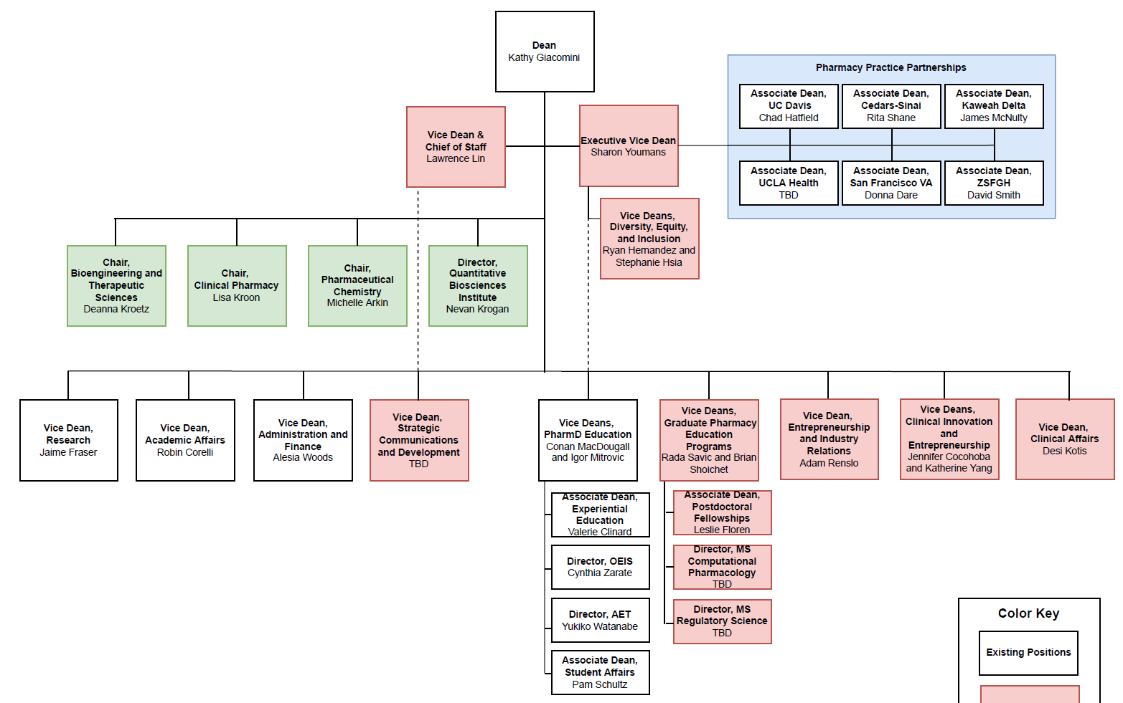
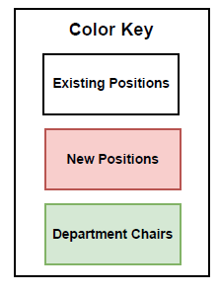
Org Chart

Slide 17
Leadership Spotlight:
Educational Opportunities

