Slide 1

We will begin soon
Town Hall
Return to On-site Work
February 24, 2022

Slide 2
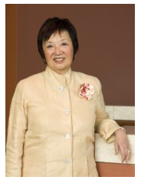
Mary Anne Koda-Kimble Seed Award for Innovation
This award funds truly innovative projects that have the potential to move forward the mission of the UCSF School of Pharmacy in new ways.
Applicants are encouraged to bring forward their boldest, riskiest, and most blue-sky ideas—those for which there is no ready or traditional source of funding. Projects may be large or small in scope.
Mary Anne Koda-Kimble, PharmD
School of Pharmacy Town Hall

Slide 3
FY2022 Award Recipients (1 of 2)
Elucidating Cellular Impacts of Hsp-independent CHIP Ubiquitination on Proteostasis
PI: Emily Connelly, PhD student, PSPG
Pilot Study by Alliance for Pharmacy Sustainability to Promote and Implement Pharmacy Stock Bottle Recycling Programs in Community Pharmacies within the Greater San Francisco Bay Area
PI: Aiko Tompkins, PharmD Class of 2023
Health Education And Literacy Rx (Heal-Rx) for diverse populations by PharmD Students
PI: Sukhmanpreet Kaur, PharmD Class of 2023
Improved Design of Protein Functions using Deep Learning
PI: Benjamin Orr, PhD student, Biophysics

Slide 4
FY2022 Award Recipients (2 of 2)
Effectiveness of oral anticoagulants reducing incidence of dementia in low stroke-risk older patients with atrial fibrillation: A pilot cohort study applying novel sensitivity analysis
PI: Zhixin Lun, postdoc, CP
Targeting drug tolerant persister cells to prevent cancer evolution under pharmacological pressure
PI: Dmitry Kuchenov , postdoc, BTS
BAYS Program: Creating Pipelines to UCSF
PI: Emma Gunderson, staff, PC; Chase Webb, PhD student, PSPG

Slide 5
Gallup Staff Engagement Survey

Slide 6

URL: https://pharmacy.ucsf.edu/deans-office/academic-affairs

Slide 7
Gallup Ambassadors 2022
Unit | Ambassador
Dean’s Office | Liana Crosby
OEIS | Rickey Lee Bauman
OEIS | Tia-Jane Desplancke
Pharmaceutical Chemistry | Emma Gunderson
BTS | Frances Peterson
Clinical Pharmacy | Angela Galvis
Poison Control | Paul Dertien
School of Pharmacy Town Hall

Slide 8
March 1: Return to On-site Work
Vaccine booster: March 1 deadline
occupationalhealthprogram.ucsf.edu
Adhere to campus COVID rules including daily health screener, masking, and vaccination or testing requirements.
coronavirus.ucsf.edu/campus-protocols
What to do after a positive COVID test?
coronavirus.ucsf.edu/return-onsite-work-guidelines
Telework agreements complete by March 1 if outstanding.
via PeopleConnect (in MyAccess), will affect space
Office etiquette — masking, eating, sharing workspace, sick notices, remote connectivity, ergonomics for home space.
coronavirus.ucsf.edu/dining

Slide 9
Pharm Chem
Return to Work Plan for Administrative Staff
UCSF School of Pharmacy

Slide 10
What factors do we consider for flexible telework?
Space | Retain space
Faculty Support (admin/finance/operations) | Faculty are on-site
Aligning with other SOP/other basic science dept. | Consistency and joint appointments
Talent Retention | Providing telework options
Equipment and Technology | Cost of ongoing equipment costs and technology provided onsite
Ergonomic Work Space | Employee safety and work injury prevention
Culture and Connection | Zoom does not replace in real life human interaction

Slide 11
PC’s return to work plan for March – June 2022
Fully On-site or the Optional Flexible Telework
Fully On-site:
If your job duties require you to be onsite at a UCSF location OR you do not have the equipment, space, technology for a home office.
Flexible Telework: Option to Telework 2 days a week
You have a home office with ergonomic equipment, work equipment, and reliable technology
You can do your work from home and does not require you to be in the office for a few days a week
One consistent day a week for everyone to be on-site. Pharm Chem staff’s designated on-site day is Tuesday.
  These consistent days we will have Staff Check In and DEI Monthly session as these are mandatory meetings
One day employee chooses day to come in, examples …
  Finance Team: for deposits, PI meetings, monthly meetings, presentations to Chair/CAO
  Faculty Support: faculty support, event set up, meetings
  Operations Support: meetings, trainings, campus meetings, space inventory, etc.
If you should experience internet outage or situation at home where you cannot access UCSF network or applications to do you job, expectation is for you to come into your UCSF office or find a secure location to conduct UCSF work. This may depend on time of day or circumstances, please consult with your supervisor.

Slide 12
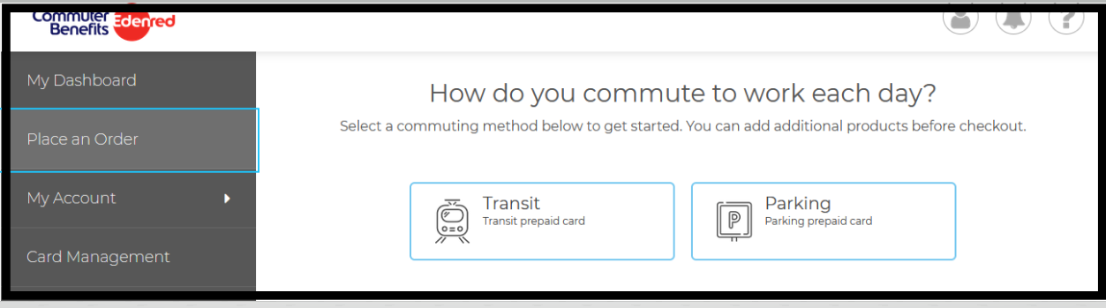
Return to Onsite Work – Preparing
Remain Flexible
There may be times you’ll be required to come in extra days, depending on the work that you do.
Variants. We don’t know what the future holds with variants and may revert back into shelter in place.
Commuter Benefits
Set up commuter benefits: https://login.commuterbenefits.com/
  Pre-Tax amount will be deducted from your pay check
  New User Setup, use Company ID: 1550
https://campuslifeservices.ucsf.edu/upload/transportation/files/Detailed_Rate_Chart.pdf
https://campuslifeservices.ucsf.edu/transportation/services/parking
Child and Elder Care
Resume aftercare and childcare as you did prior to the pandemic
UCSF Resources:
  https://campuslifeservices.ucsf.edu/familyservices/services/child_care_referral_service
  https://campuslifeservices.ucsf.edu/familyservices/services/adult_elder_care_resources

Slide 13
Clinical Pharmacy
Return to Work Update for Administrative Staff
UCSF School of Pharmacy

Slide 14

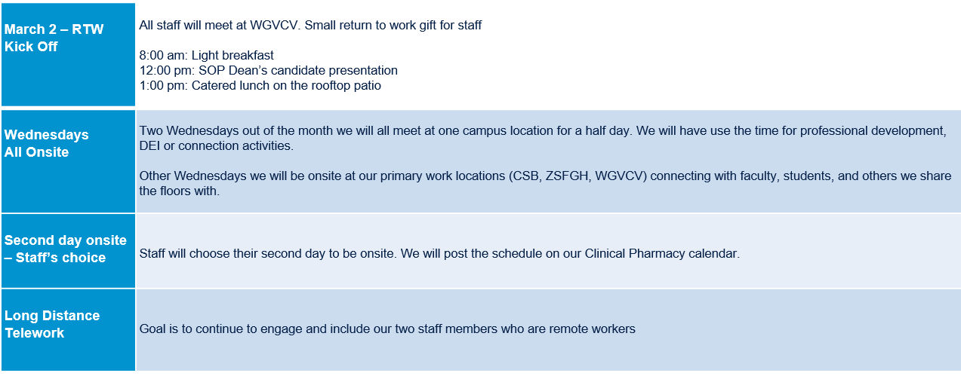

Slide 15
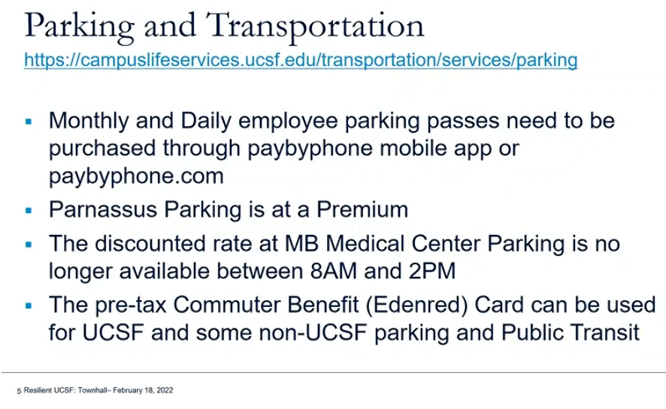
Return to Onsite Work – Preparing
Remain Flexible
If you are two days in, there may be times you’ll be required to come in extra days, depending on the work that you do.
Variants. We don’t know what the future holds with variants and may revert back into shelter in place.
Commuter Benefits
Set up commuter benefits: https://login.commuterbenefits.com/
  Pre-Tax amount will be deducted from your pay check
  New User Setup, use Company ID: 1550
https://campuslifeservices.ucsf.edu/upload/transportation/files/Detailed_Rate_Chart.pdf
https://campuslifeservices.ucsf.edu/transportation/services/parking
Child and Elder Care
Resume aftercare and childcare as you did prior to the pandemic
UCSF Resources:
  https://campuslifeservices.ucsf.edu/familyservices/services/child_care_referral_service
  https://campuslifeservices.ucsf.edu/familyservices/services/adult_elder_care_resources

