Slide 1

School Town Hall
Updates from the Dean
Clinical Pharmacogenomics Program
Strategic Planning Process
March 2, 2023

Slide 2
Agenda
Updates from the Dean
Clinical Pharmacogenomics Program
School Strategic Planning Process
Panel Discussion and Q&A

Slide 3
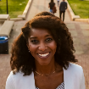
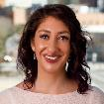
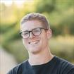
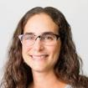
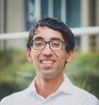
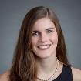
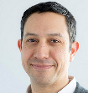
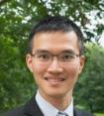
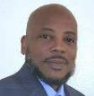
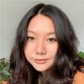
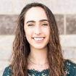
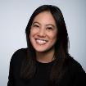
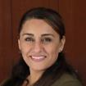
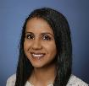
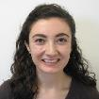

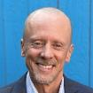
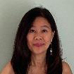
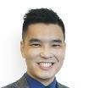
Welcome to Our New Faculty and Staff (Since Jan 2022)
New Faculty
New Staff
BTS
Catera Wilder, PhD
Kyle Cromer, PhD (joint)
Arun Wiita, MD, PhD (joint)
Christopher Hernandez, PhD (joint)
Clinical Pharmacy
Shannan Takhar, PharmD
Emily Mrig, PhD
Beth Winger, MD, PhD
Amelia Deitchman, PharmD, PhD
Pharmaceutical Chemistry
Kevin Leung, PhD
Katherine Susa, PhD
BTS
Shondell Moody (CAO)
Wan-Yu Lai
Clinical Pharmacy
Alexandra Diiorio
Yvette Hellier
Jeanie Tran
Dean’s Office
Ryan Johannesen
Nathan Dang
Joanne Chun
Pharmaceutical Chemistry
Kimberly Cantero (CAO)
Arezou Razavi
Francisco Noriega
Notes:
We have a number of new people: New faculty from BTS, Clin Pharma and Pharm Chem
We have new staff from each of the departments, and the deans office and QBI
So if you see them here at retreat. Please welcome them or on campus.

Slide 4
Updates
Develop and support our faculty, students and staff
  Dean’s Office sponsoring happy hours for faculty / staff / postdocs
  Genentech-UCSF School of Pharmacy PhD Student Diversity Fellowship
Create new opportunities for PharmD students
  Finalizing agreement for new APPE slots at Pfizer San Diego
  Computational Drug Discovery Master's Program
  Hiring new teaching faculty in basic science departments
  2023 PharmD Admissions To Date
Accepted | Waitlisted | Accepted offer
155 | 32 | 52

Slide 5
Updates (continued)
Foster transformative partnerships
  QBI mini-symposium on emerging infectious disease on 2/28
  Launch of new Clinical Pharmacogenomics Program
  UCSF Representation at AACP Annual Meeting (July)
Type | Authors | Title
Mini | Kathy Giacomini / Lawrence Lin | How Can Pharmacy School Faculty Get Research Funding from FDA?
CPD Section | Tram Cat | Surviving to Thriving: What’s New in Continuing Professional Development
Mini | Laura Armstrong / Yukiko Watanabe | Low tech course-level mapping report
Mini | Julie Reed / Conan MacDougall | Structured Communication Methods, QUILT & Critical Reflection
Mini | Stephanie Hsia | Structural competency curricula
Mini | Val Clinard / Kirsten Balano | How do other professions evaluate student pharmacists: APPE-based Interprofessional Evaluation of student pharmacists

Slide 6
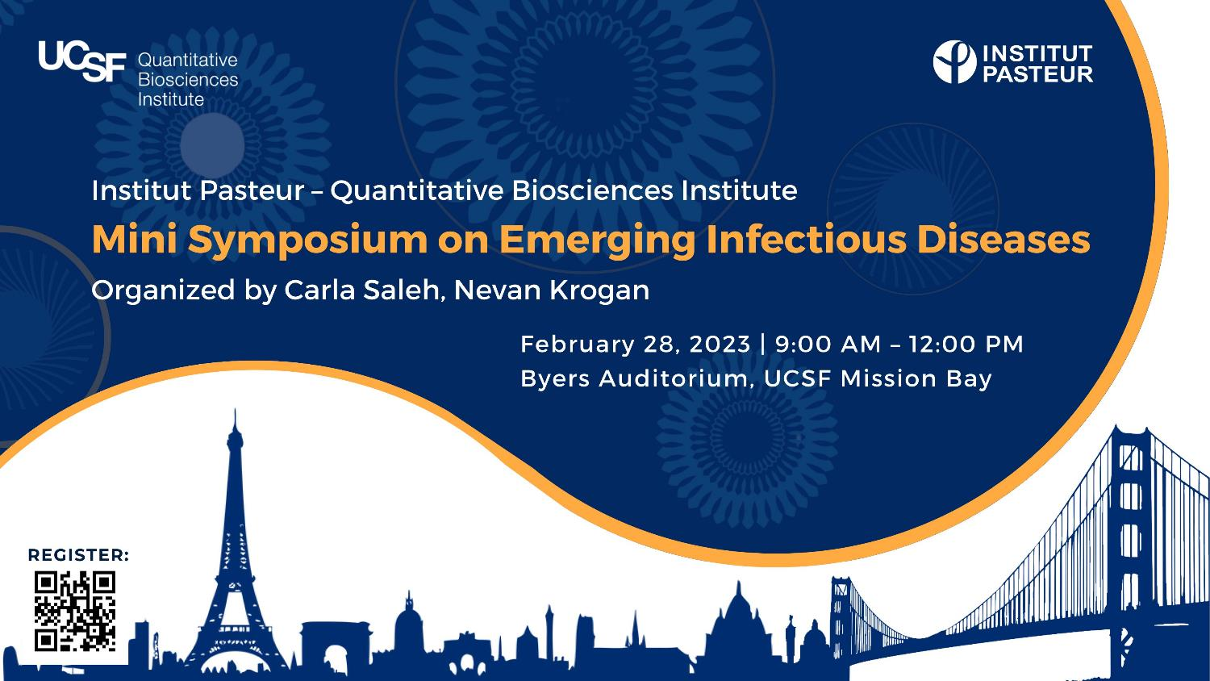

Slide 7
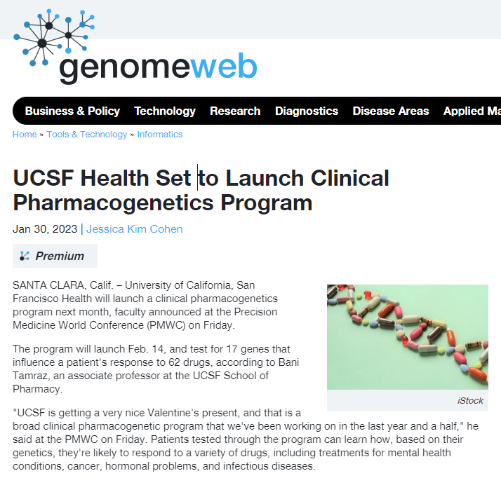
Congratulations
Bani Tamraz and
Lisa Kroon!

Slide 8
School Strategic Planning Process

Slide 9
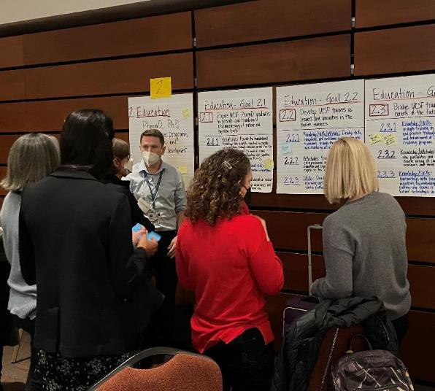
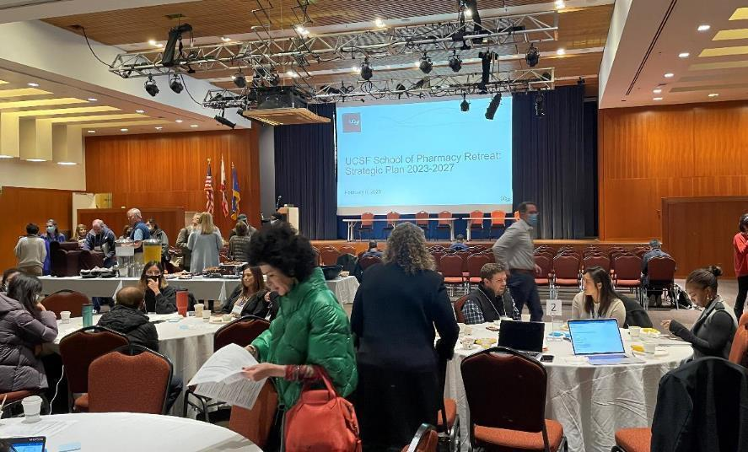
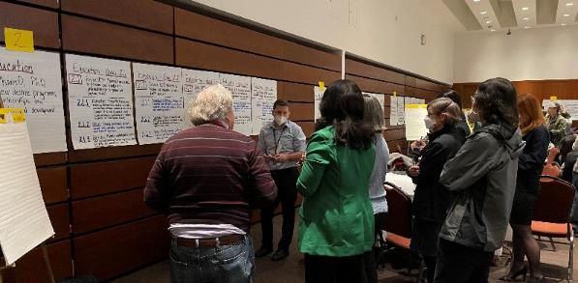
School of Pharmacy Retreat 2/6
107 attendees: faculty, staff, students, alumni, UCSF leaders

Slide 10
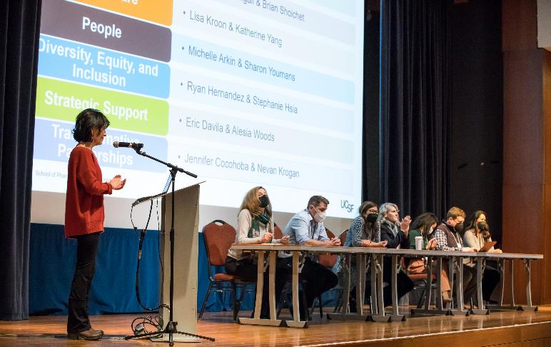
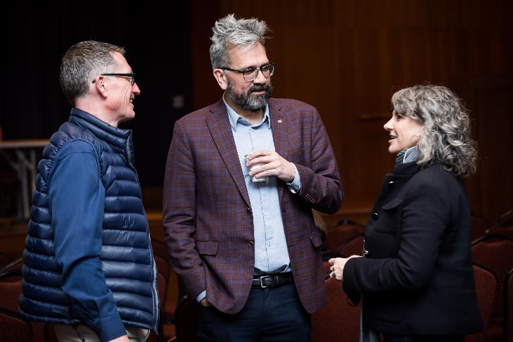
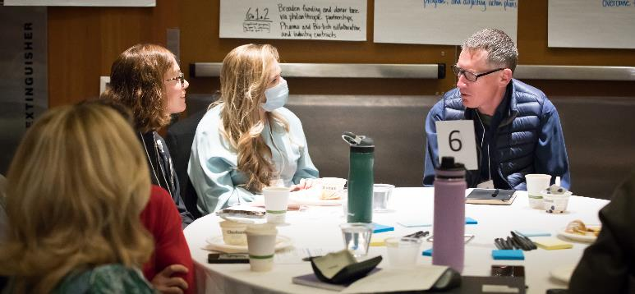
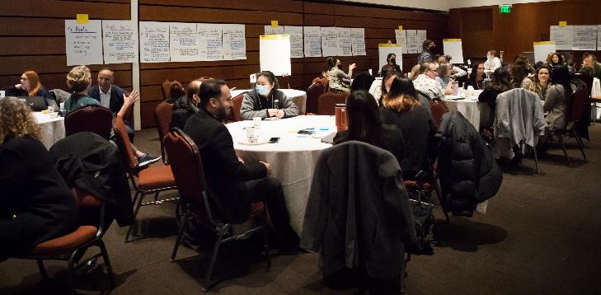

Slide 11
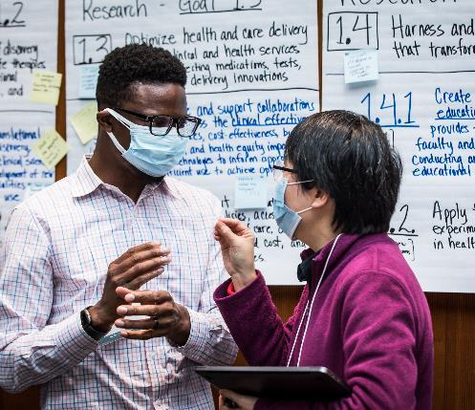
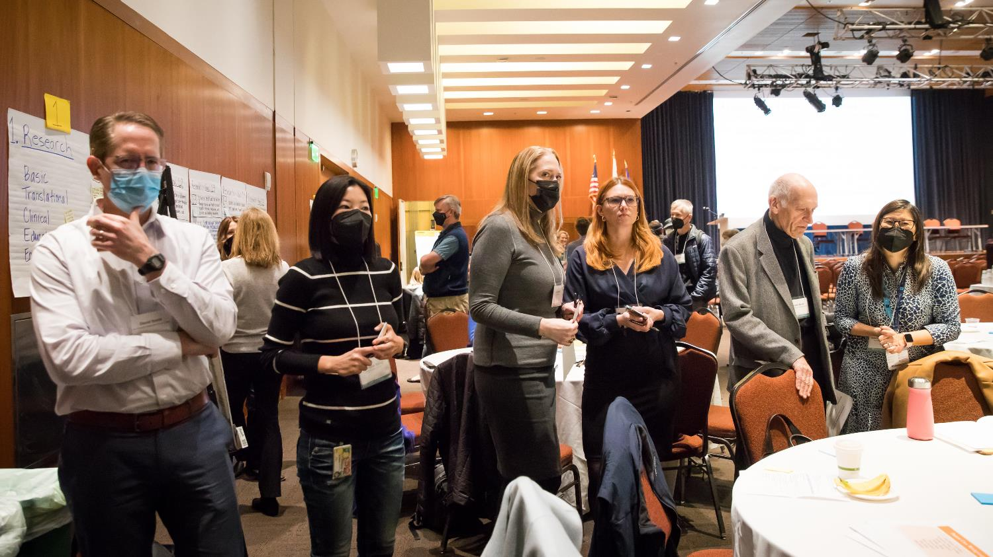
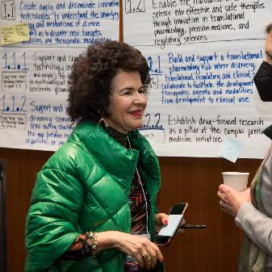
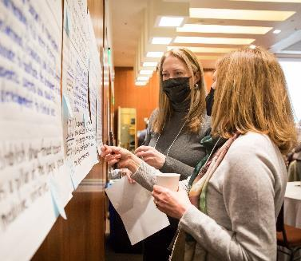

Slide 12
Development Process for Strategic Plan
Sept 6
Sept 13
Oct 20
Oct 25
Nov 10
Nov 22
Dec 8
Dec 13
January
Dean’s Faculty Advisory Cmte
Leadership Group
Faculty Council
Dean’s Faculty Advisory Cmte
Faculty
Council
Leadership Group
Faculty
Council
Leadership Group
Strategic Priority Workgroups
Drafted Strategic Priorities and Goals
Revised
Strategic Priorities and Goals
Reviewed Strategic Plan process
Drafted Mission & Vision; reviewed Strategic Priorities
and Goals
Reviewed Mission & Vision, Strategic Priorities
and Goals
Refined
Mission & Vision, Strategic Priorities
and Goals
Refined
Mission & Vision, Strategic Priorities
and Goals
Reviewed feedback from FC; confirmed Strategic Priorities
and Goals
Refined
Strategic Priorities and Goals; Drafted Sub-goals
Notes:
Let’s look now move to the strategic plan
Lots of meeting especially with the Leadership Group, the dean’s faculty advisory committee, and Faculty Council;
Then the workgroups have been meetng since ;
The work of all of these groups draft; Bring today to get feedback from a wider group; school and beyond. Each work group had diverse representation from.
The goal of today’s retreat is to look at the subgoals and help the leadership team identify the prorities; You’ll learn about what the subgoals are when you visit each station; and will have an opportunity provide some input.

Slide 13
Development Process for Strategic Plan
Feb 6
Feb - Mar
Apr 11
May
On-going
Quarterly
Strategic Plan Retreat
Strategic Priority Workgroups
Leadership Group
Communication
Leadership Group
Communicate and distribute strategic plan across school and campus
Review progress and update as needed
Affirm mission / vision statements; Refine and prioritize subgoals
Develop action plans and metrics for subgoals
Review action plans and metrics
Notes:
Review timeline for Town Hall (late-Feb), action plans & metrics (early March), LG review of plans & metrics (April), LG on-going review of progress on goals/sub-goals (quarterly)

Slide 14
New Vision and Mission Statements
Vision
To be the global leader in innovating pharmacy education, biomedical research, and health care.
Mission
The UCSF School of Pharmacy leads in research, education, clinical care, and entrepreneurship to expand knowledge and improve the health of people everywhere.
Notes:
I am proud to share our updated Mission and Vision Statements, which were developed by the Leadership Group, Faculty Council and the Dean’s Faculty Advisory Committee.
Stephanie will share instructions on how you can provide your feedback using Poll Everywhere

Slide 15
Strategic Priority Co-Leads
Diversity, Equity, and Inclusion
People
Strategic Support
Transformative Partnerships
Research
Patient Care
Education
Robin Corelli & Tanja Kortemme
Conan MacDougall & Brian Shoichet
Lisa Kroon & Katherine Yang
Michelle Arkin & Sharon Youmans
Ryan Hernandez & Stephanie Hsia
Eric Davila & Alesia Woods
Jennifer Cocohoba & Nevan Krogan

Slide 16
Research Workgroup
Robin Corelli, Co-lead
Tanja Kortemme, Co-lead
Steven Altschuler
Bill Degrado
Bo Huang
Deanna Kroetz
Akin Oni-Orisan
Kathryn Phillips
Catera Wilder

Slide 17
1. Research
1.1 Develop the mechanistic understanding, technology, and translational strategies to find treatments for all human diseases
1.2 Optimize health and care delivery through clinical and health services research affecting medications, tests, devices and delivery innovations
1.3 Harness and conduct research that transforms PharmD education
1.4 Enable and reward entrepreneurship of our faculty, staff, and trainees, who engage in founding and collaborating with companies and other strategic partnerships

Slide 18
Education Workgroup
Conan MacDougall, Co-lead
Brian Shoichet, Co-lead
Mandy Brown
Leslie Floren
Katherine Gruenberg
Igor Mitrovic

Slide 19
2. Education
2.1 Prepare UCSF PharmD graduates to provide and transform pharmacotherapy at patient and systems levels
2.2 Develop UCSF trainees as leaders and innovators in the health sciences
2.3 Bridge UCSF trainees into careers of the future
2.4 Make UCSF the desired destination to build a career in biomedical and pharmacotherapeutic science and practice
2.5 Expand UCSF’s education footprint along the entire career arc
2.6 Leverage and develop educational technologies and faculty/staff expertise to
deliver and transform health professions education

Slide 20
Patient Care Workgroup
Lisa Kroon, Co-lead
Katherine Yang, Co-lead
Ashley Thompson
Shirley Wong
Donna Dare
Matt Jacobson
Desi Kotis
Rita Shane

Slide 21
3. Patient Care
3.1 Pharmacists take ownership of medication management with emphasis on
vulnerable, high-risk patients to optimize health outcomes.
3.2 Translate health data to design precise, safe, and cost-effective medication therapies
for individual patients and populations

Slide 22
People Workgroup
Michelle Arkin and Sharon Youmans, Co-leads
Su Guo
Karen Hamblett
Ray Ho
Justin Lewis
Aashish Manglik
Keya Patel
Caleb Rux
Zi Yao

Slide 23
4. People
4.1: Enhance faculty, trainees, and staff well-being and recognize excellence and service, while supporting work-life balance
4.2: Recruit and retain exceptional and diverse faculty, trainees, and staff
4.3: Increase collaboration between clinical, translational, and discovery science faculty in teaching and research
4.4: Increase alumni involvement in the life of the School
4.5: Provide faculty, staff, and trainees mentoring and professional development

Slide 24
Diversity, Equity & Inclusion Workgroup
Ryan Hernandez, Co-lead
Stephanie Hsia, Co-lead
Danica Fujimori
Joel Gonzales
Michael Keiser
Daisha Matthews
Rupa Tuan
Samantha Valle-Oseguera
Carla Washington

Slide 25
5. DEI
5.1 Cultivate a culture of diversity, equity, and inclusion (DEI) among trainees, faculty, and staff in the school
5.2 Establish the infrastructure, programs, and events to support DEI efforts
5.3 Ensure all communications of the school, including web pages, posters, and newsletters, are culturally sensitive and adequately represent DEI efforts
5.4 Increase recruitment and retention of diverse trainees, faculty, and staff
5.5 Develop inclusive, equity-minded professionals through anti-oppressive curricula
Notes:
UCSF DEI Priorities, Goals, and Task Force Reports:
https://chancellor.ucsf.edu/priorities#equityandinclusion
https://diversity.ucsf.edu/sites/default/files/2022-12/ODO%20Annual%20Report_2021_2022.pdf
https://graduate.ucsf.edu/news/task-force-calls-concrete-actions-dismantle-systemic-racism
https://research.ucsf.edu/sites/g/files/tkssra2931/f/UCSF_Task_Force_Report_Final_Anti-Racism_in_Research_IDEA.pdf

Slide 26
Strategic Support Workgroup
Eric Davila, Co-lead
Alesia Woods, Co-lead
Adam Abate
Kim Cantero
Jaime Fraser
Bo O’Hare
Adam Renslo
Jim Wells
Beth Winger

Slide 27
6. Strategic Support
6.1 Expand and diversify our sources of revenue and other support for faculty and learners
6.2 Support the Strategic Plan with necessary infrastructure
6.3 Enable School success by addressing internal barriers that hamper faculty and staff productivity
6.4 Enhance the school’s reputation, visibility, and audience engagement through strategic communications, both externally and internally

Slide 28
Transformative Partnerships Workgroup
Jennifer Cocohoba, Co-lead
Nevan Krogan, Co-lead
Kevin Rodondi
Andrej Sali
Seth Shipman
Marilyn Stebbins
Bani Tamraz
Balyn Zaro

Slide 29
7. Transformative Partnerships
7.1 To advance our education, research and clinical missions, establish transformative partnerships with national and international organizations including other academic and health institutions, non-profit entities, professional organizations, and for-profit companies
7.2 Facilitate the creation and goals of partnerships with external organizations by streamlining internal policies and processes including processes for contracts, material and data transfer, intellectual property, and student/faculty exchange
7.3 Showcase transformative partnerships through robust communications

Slide 30
Panel Discussion and Q&A:
Strategic Plan

