Slide 1

AI at UCSF
SOP Town Hall
Ida Sim, MD, PhD, UCSF CRIO
October 17, 2023
Notes:
https://www.istockphoto.com/search/2/image?mediatype=illustration&phrase=knowledge+tree free use

Slide 2
Research and Funding Context
Discovery and clinical research grants increasingly incorporating AI/ML
  450% growth in “machine learning” NIH grants 2017-2022
  Major ARPA-H, NSF, NIH and IC-specific RFAs (e.g., NCI, NHLBI)
Implementation science grants increasingly require integration of digital health and decision support into health system
  AHRQ, PCORI, NSF SMART Health, etc.
UCSF must provide a first-class infrastructure for next-generation computing to attract and retain talent and to maintain research leadership
Office of the CRIO, October 17, 2023
Notes:
Positioning scope of work of CRIO
2017 to 2022: from 1032 to 4607, 2023 already exceeding all of 2022, so will be close to 6000
computing is dry labs new microscopy, new sequencing, etc. MUST go beyond IT to KC
Eg computational path, retention risk

Slide 3
Broad Vision for AI at UCSF
By harnessing the full range of computational technologies including analytic and generative AI, UCSF faculty will Advance Health Worldwide through multi-modal multi-scale computing not previously possible
  to connect and understand the mechanisms of health and disease from the molecular to the individual to the community (informed by AI Discovery Retreat)
  to use knowledge computing to apply these mechanistic understandings to improve the care our patients receive at UCSF Health (informed by AI Clinical Retreat)
UCSF will build for anticipated shifts in what and how research is conducted
UCSF will be a model for fair, equitable, compassionate, and trustworthy use of AI
Notes:
Frame as what’s good for UCSF, how partnership fits in and align to larger goal

Slide 4
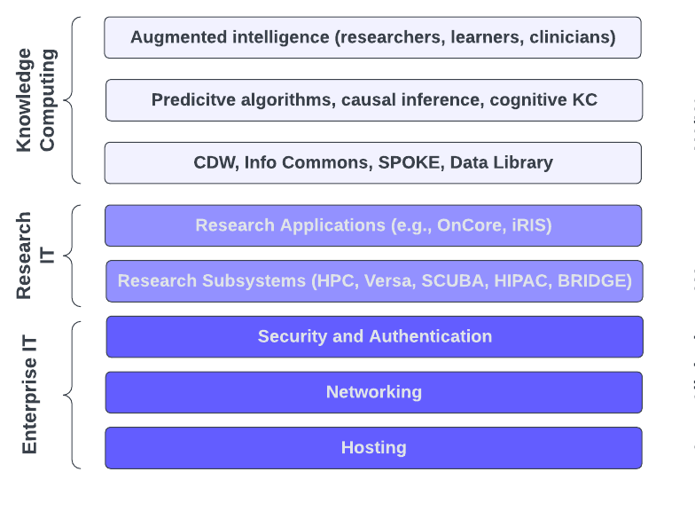
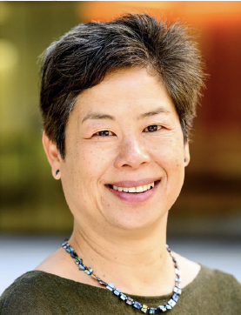
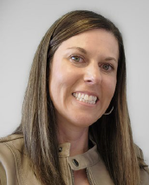
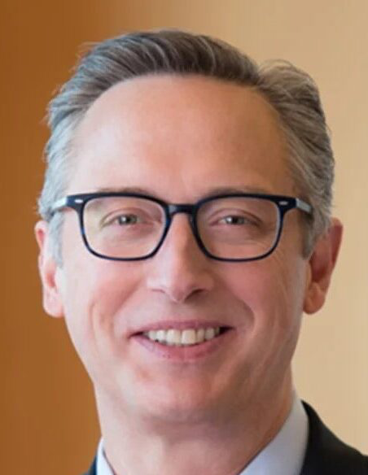
Knowledge Computing and Relationship to IT
Knowledge Computing: the science of designing, developing, evaluating, and applying specialized algorithms, AI/machine learning, and hyperscale scientific data and infrastructures
…to augment human cognition (researchers, clinicians, learners, patients) for advancing biomedical discovery, clinical care, and education
CRIO
Ida Sim
ACIO-R
Mandy Terrill
CIO
Joe Bengfort
All components of the technology stack are essential
Office of the CRIO, October 17, 2023
Notes:
Stack is a useful metaphor to carry through

Slide 5


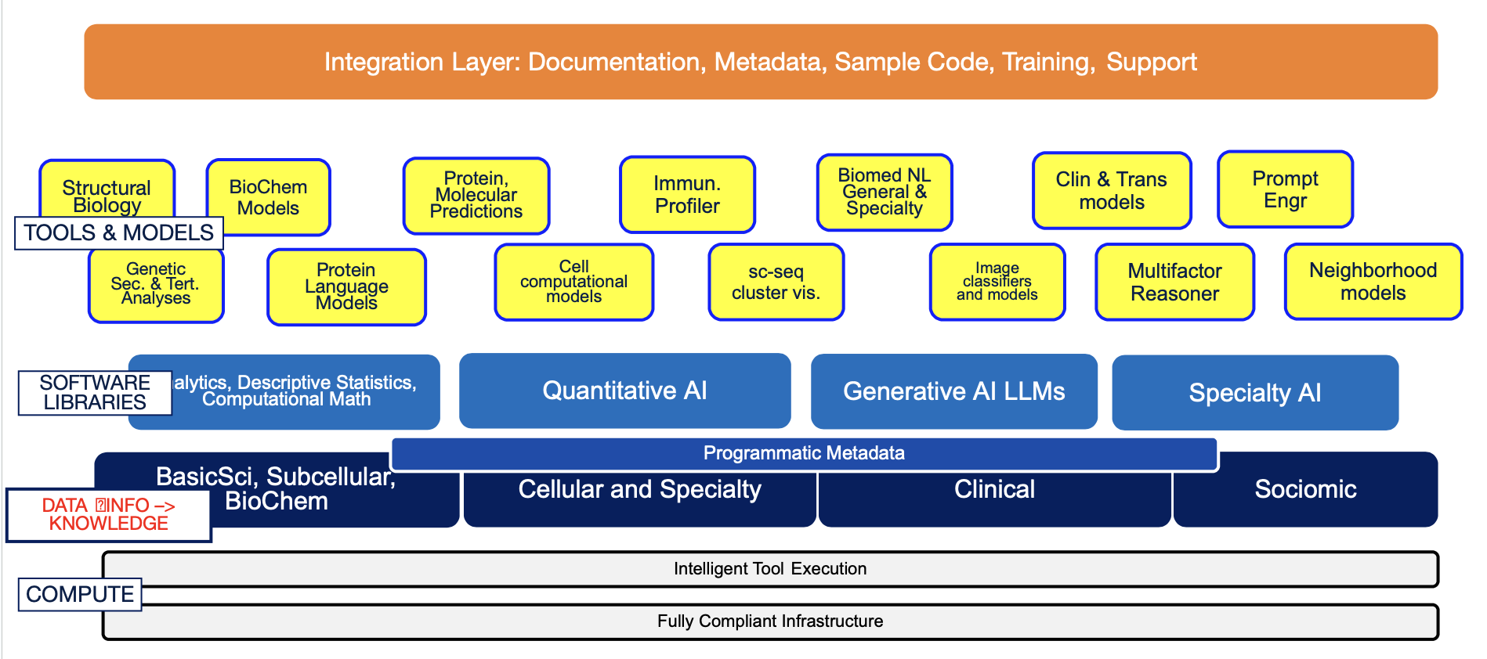

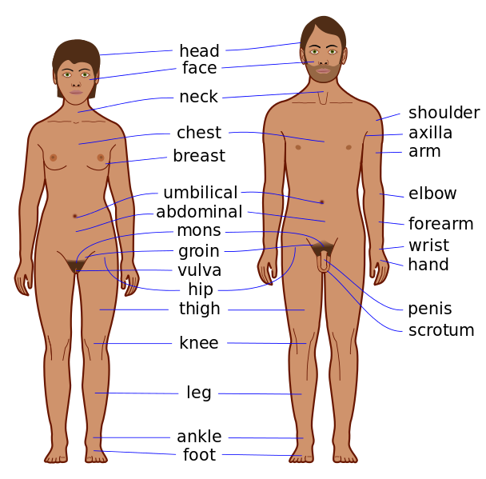
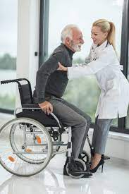

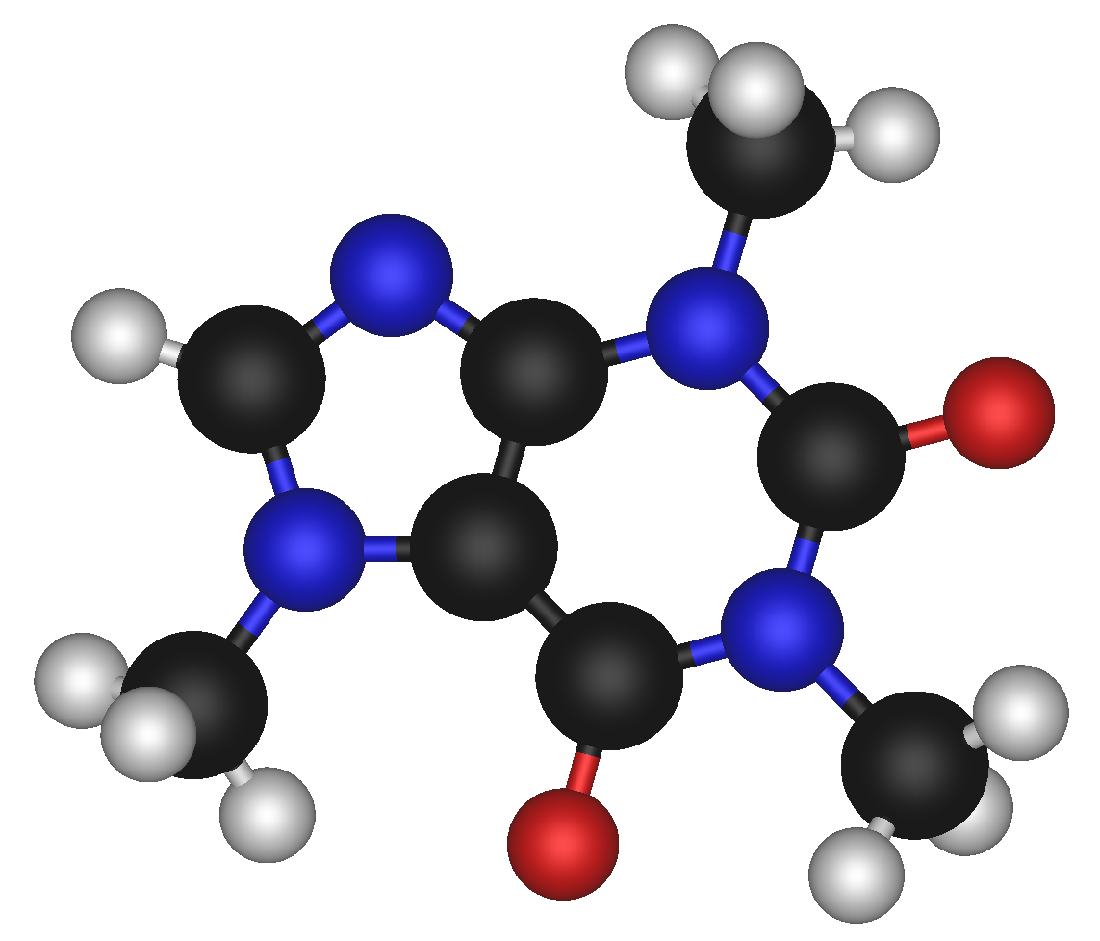
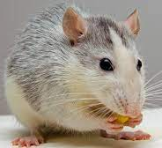
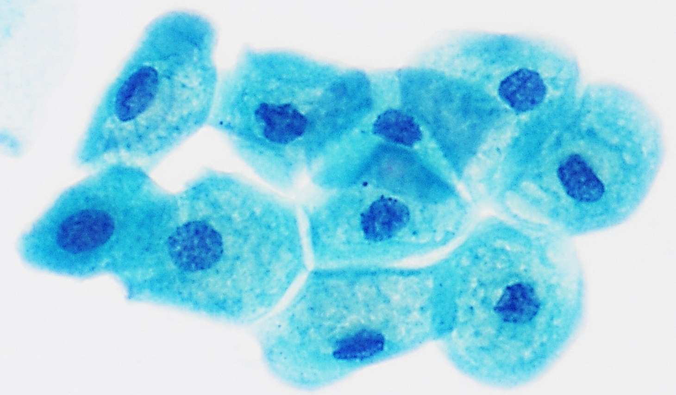
Knowledge Computing across UCSF
Decision Support
Learning Health System
Digital Virtual Health
Remote patient monitoring
Generative AI
Decentralized trials
Predictive analytics
Accuracy, Fairness, Equity
Multi-scale Multi-modal Discovery
KC-Driven Precision Health
molecules
cells
organs
organisms
people
patients
communities
Notes:
Identifying leapfrog opportunities
HIPAC

Slide 6
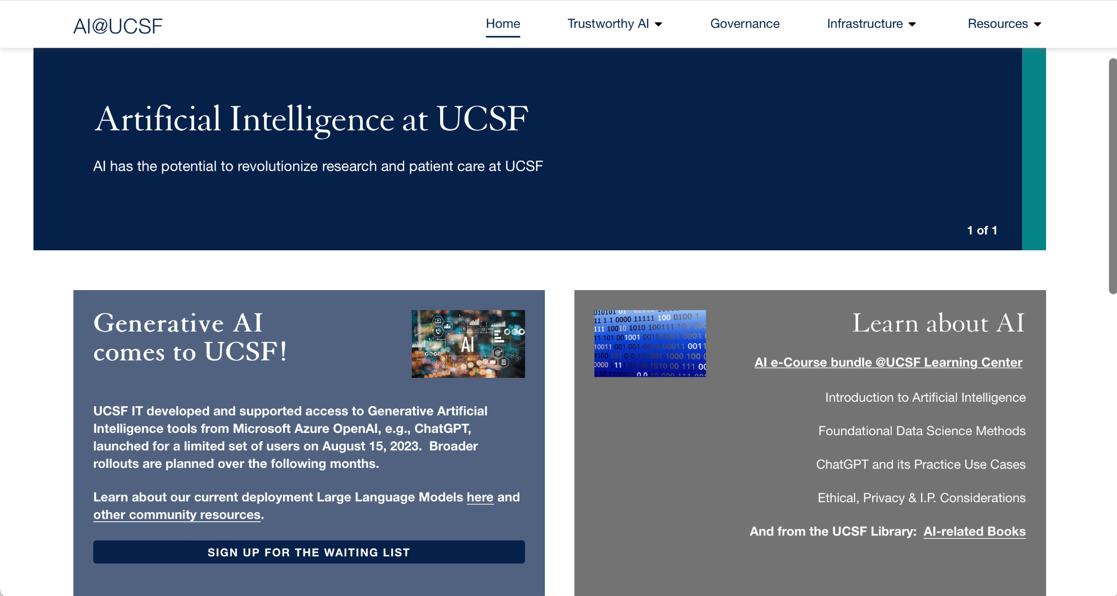
http://ai.ucsf.edu

Slide 7
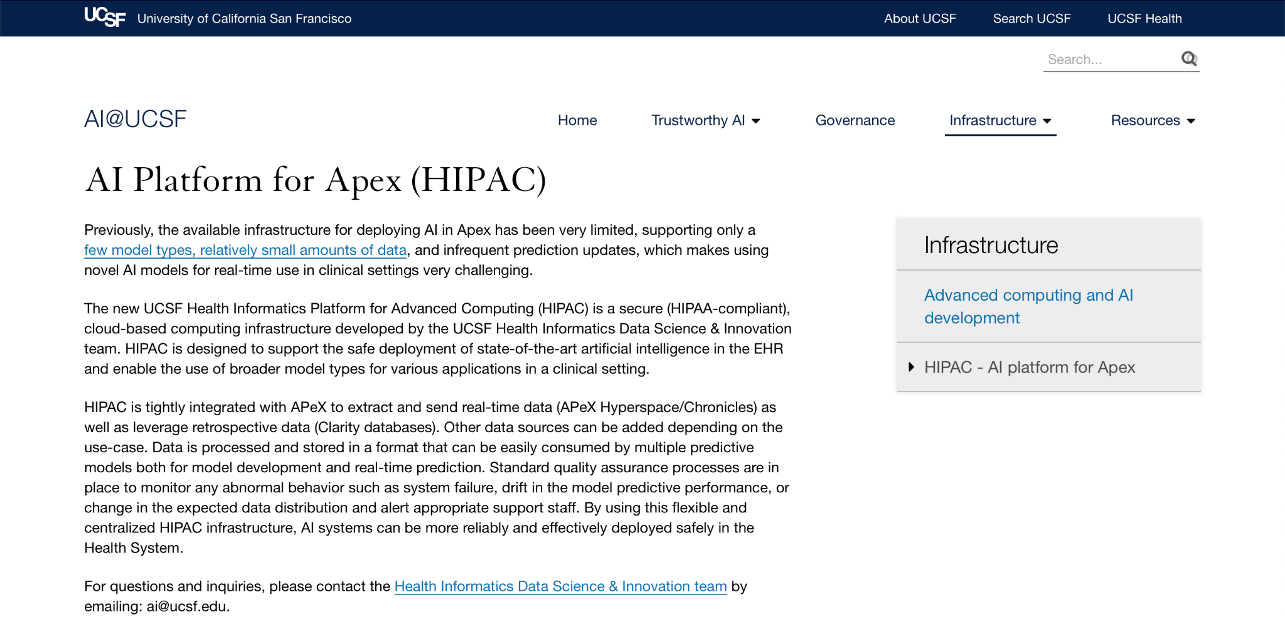
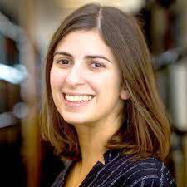
http://ai.ucsf.edu
secure (HIPAA-compliant), cloud-based computing infrastructure
supports the safe deployment of state-of-the-art artificial intelligence in the EHR and enable the use of broader model types for various applications in a clinical setting.
tightly integrated with APeX to extract and send real-time data (APeX Hyperspace/Chronicles) as well as leverage retrospective data (Clarity databases)
For questions and inquiries, please contact the Health Informatics Data Science & Innovation team by emailing: ai@ucsf.edu.
Sara Murray
Chief Health AI Officer

Slide 8
High Performance Computing (with ACIO-R)
Implement a Phased Model for building out an HPC Core
Support Wynton (current UCSF HPC environment)
Submit funding/operational request
  New cluster (CPUs and GPUs)
  Governance and oversight of the Core
Notes:
Evolving landscape

Slide 9
CRIO-led Workstreams
Gap Analysis
Proof of Concept
Ongoing Prioritization
and Evaluation
Applied Ethics | Identify / Disseminate core ethical principles (e.g., CHAI); Develop and implement risk-based frameworks; Develop and implement Fairness/Bias reporting metrics; Lead on national AI regulation and policy
Training | Identify and provide training on core “AI literacy” skills; train researchers on standards for algo evaluation, monitoring, and proof-of-value;
Evaluation/ Monitoring | Co-lead Algorithmic Evaluation and Monitoring Workgroup: 1) Set / Disseminate Standards for Algo Evaluation; 2) Set / Disseminate Standards for Algo Monitoring; 3) Partner with other actors to develop standards for algorithm proof-of-value
Architecture with ACIO-R, health CIO | Identify key architectural considerations and opportunities; Develop v1 knowledge computing architecture driven by pilot use cases; Develop unified real-world research platform strategy; Define and prototype AI Readiness Scorecard
Community With Comms, ACIO-R, health system, Library, Grad Div, etc. | Foster and support AI Communities of Practice; Coordinate websites, communications, and resources; Prototype a metrics-driven AI Core (e.g., code, documentation, training)
with CHAIO, IRB, AER, IRI, DD&T, Bioethics
with Bakar, Library, IT, ARS, IRI, SOM
with CHAIO, health CIO, CTSI, AER, IRB, CPH
Notes:
Too ambitious?!
Activities vs deliverables
Scorecard for AI Readiness

Slide 10
Stay Tuned
For wider Versa roll-out
For a series of lunch and learns in the Fall/Winter on generative AI
  An Overview of Generative AI
  Getting Started with AI
  IRB Considerations
For guidance and training on AI best practices, applied ethics

Slide 11
Open Discussion

