Slide 1
SOP Town Hall
Dean Kathy Giacomini
December 12, 2024

Slide 2
Today’s Agenda
Time | Topic
3:00 – 3:10 pm | Dean’s Updates (Kathy Giacomini)
3:10 – 3:25 pm | Strategic Plan Update (Sharon Youmans)
3:25 – 3:35 pm | School of Pharmacy Staff Council (Kim Cantero, Jacqueline Fabius, Karen Hamblett, and Shondell Moody)
3:35 – 3:55 pm | Introduction to Versa and Demo (Joe Owens)
3:55 – 4:00 pm | Open Audience Q&A

Slide 3


Slide 4
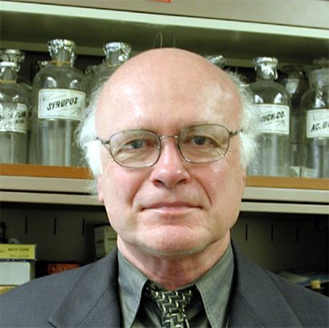
In Memoriam
Bob Day, PharmD ‘59
1934 - 2024

Slide 5
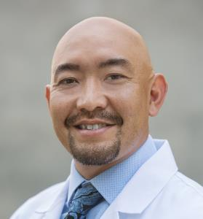
New Chair of Clinical Pharmacy
Thank you to the search committee:
  Claire Brindis (chair)
  Kathryn Phillips
  Candy Tsourounis
  Akin Oni-Orisan
  Michelle Arkin
  Mark Pletcher
  George Rutherford
  Noelle Chapman
  Shondell Moody
And especially Jen Cocohoba for serving as interim chair!
Jonathan Watanabe, PharmD, PhD
Will start on January 2, 2025

Slide 6
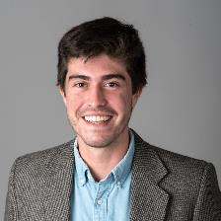
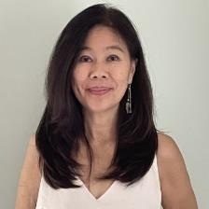
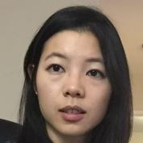
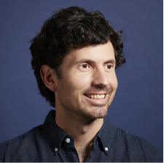
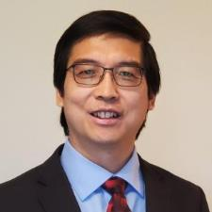
Welcome New BTS Faculty
Diego Calderon, PhD
Joanne Chun, PharmD, PhD
Michelle Wang, PharmD, PhD
Galen Correy, PhD
Liang Zhao, PhD, MAS, MBA

Slide 7
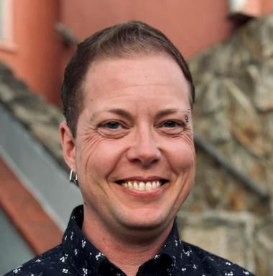
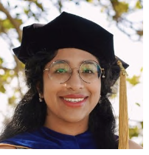
Welcome New Teaching Faculty
Tristan Storm, PharmD
Bioengineering and Therapeutic Sciences
Yessica Gomez, PhD
Pharmaceutical Chemistry

Slide 8
Welcome New Staff
Quantitative Biosciences Institute
Sukumar, Swathi
Ennis, Craig
Parekh, Sarika
Tognatta, Reshmi
Choudhury, Promisree
Pharmaceutical Chemistry
Kwan, Kelly
Childree, Gabriela
Batada, Alysha
Petkovic, Kyle
Zhang, Ralph
Maksymiuk, Roman
Leung, Kristina
Bioengineering and Therapeutic Sciences
Jumbe, Nelson
Atkin-Yamaguchi, Kina
Lam, Maggie
Dean’s Office
Lynch, Rachel
Villaro, Sabrina
Tam, Katherine
Moy, Laura
Ngai, Crystal
Richards, Alyscia
Lai, Wan-yu

Slide 9
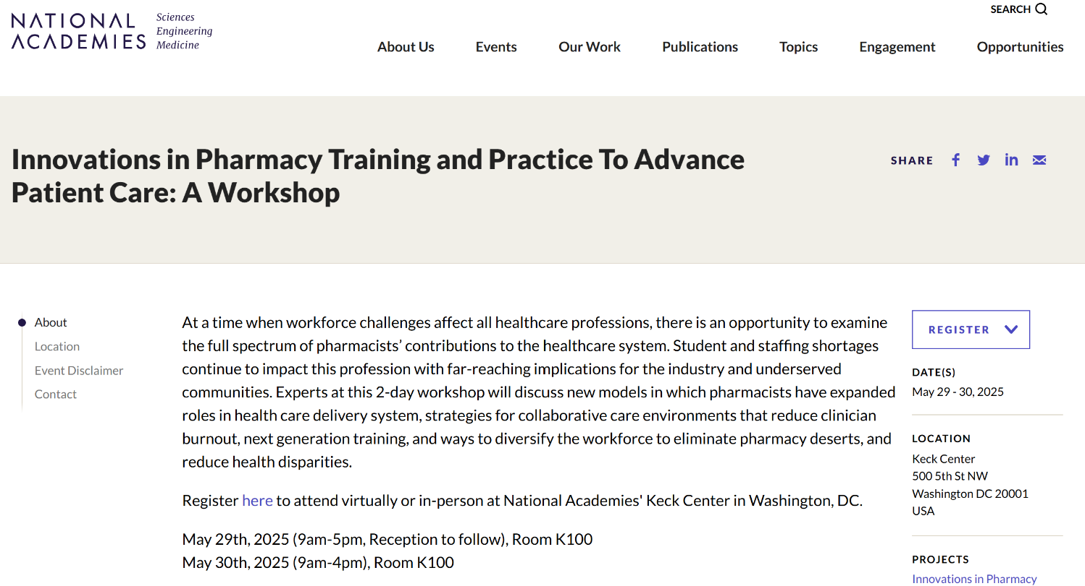
NAM Workshop: Pharmacy Workforce
Diversity, Deserts and Disparities
  pathway programs
  internship programs
  partnerships programs with institutions that serve minority
Workforce Conditions: Collaborative Care, Reducing Burnout
Model Programs with Expanded Roles
  Substance use disorders
  Reproductive health services
Next Generation Training: Beyond Patient Care:
  Biotech/Pharma Industry
Save the Date: May 29 and May 30
https://www.nationalacademies.org/our-work/innovations-in-pharmacy-training-and-practice-to-advance-patient-care-a-workshop

Slide 10
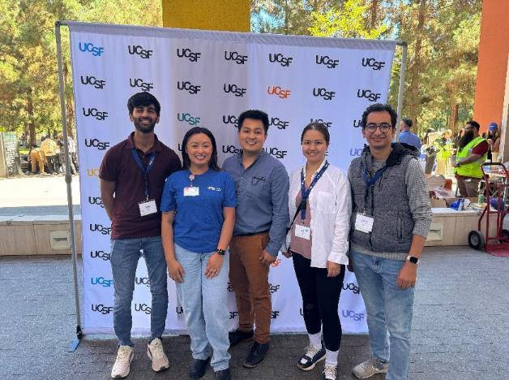
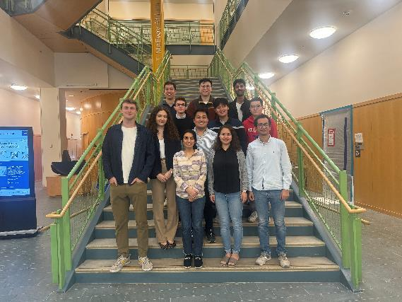
Launched AI-CD3 MS Degree Program
AICD3 students + Program Admin at Graduate Division Orientation
AICD3 Cohort at Program Orientation

Slide 11
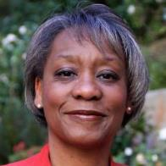
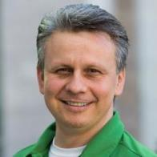
PharmD Pathway Program Updates
PharmTech to PharmD Pathway Program (Sharon Youmans)
Launching in February 2025
Presented to UCSF Health and looking to involve their pharmacy technicians in the program
Ongoing conversations with Jewish Vocational Services about involvement in their workforce development program with UCSF HR
UC Merced- UCSF Pipeline Program (Igor Mitrovic)
Received a $55,000 planning grant from Legacy Health Foundation to help students from 19 Central Valley zip codes
In discussions with other URM-serving institutions: Modesto Junior College, Columbia College, and San Francisco State University

Slide 12
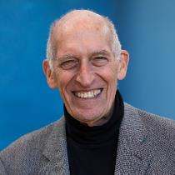
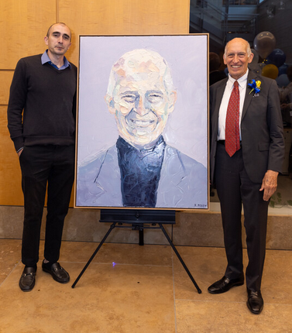
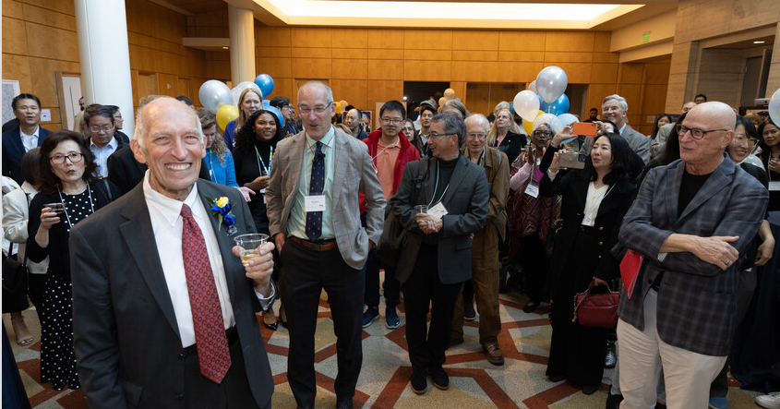
Les Benet Symposium and Endowed Professorship Celebration – May 17

Slide 13

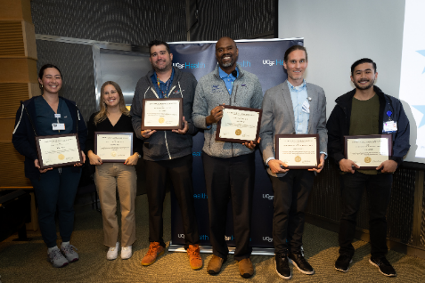
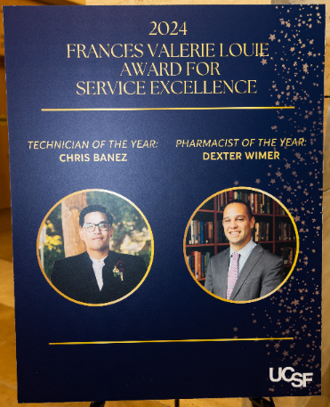
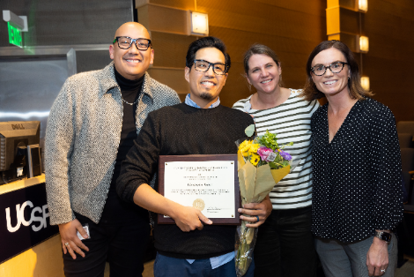
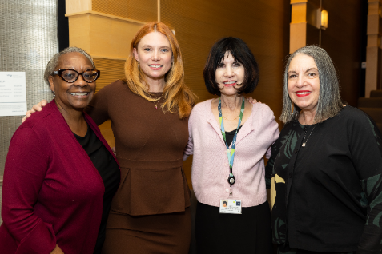
UCSF School of Pharmacy & UCSF Health
Val Louie Awards Ceremony - October 24

Slide 14
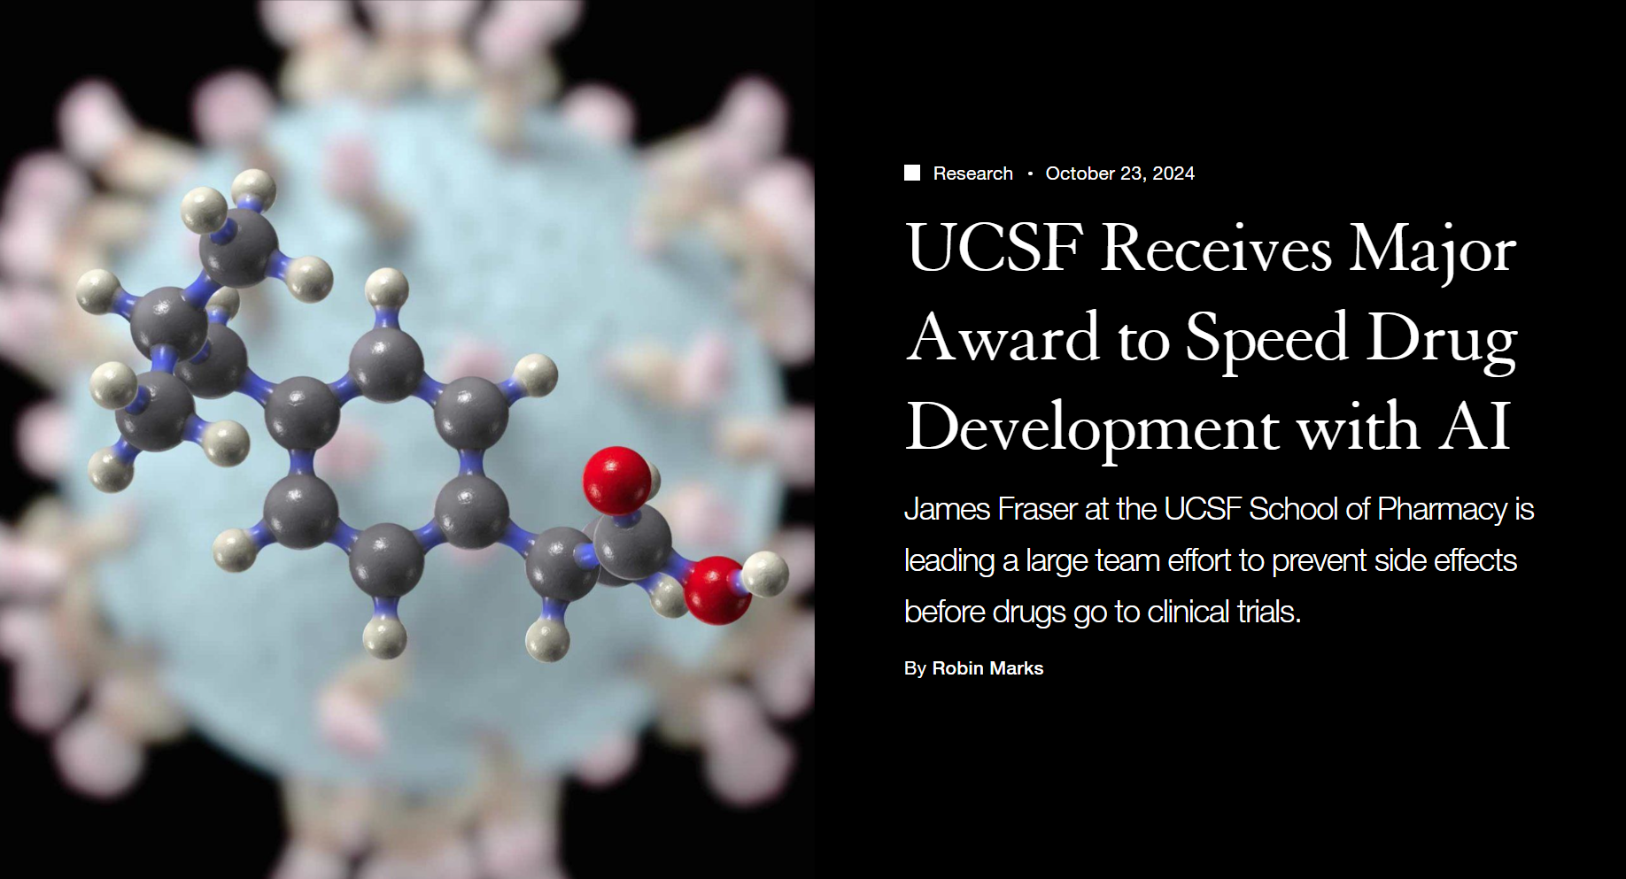
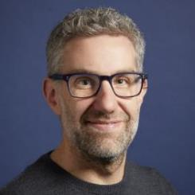


Slide 15
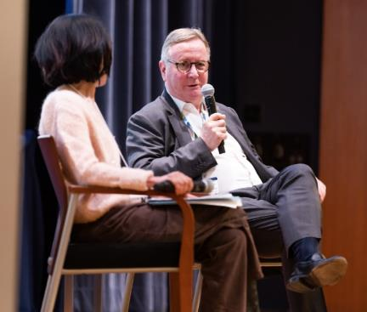
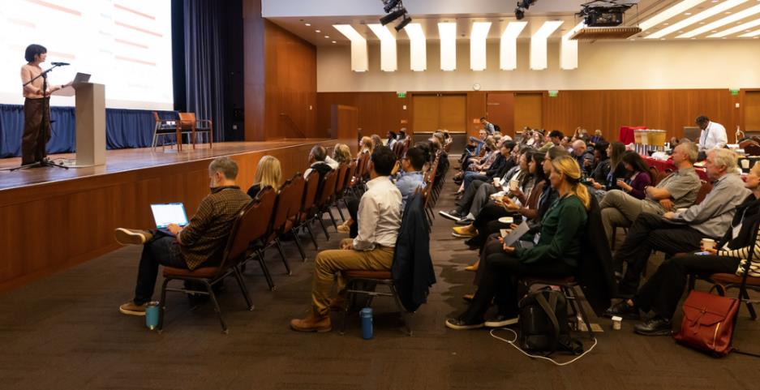
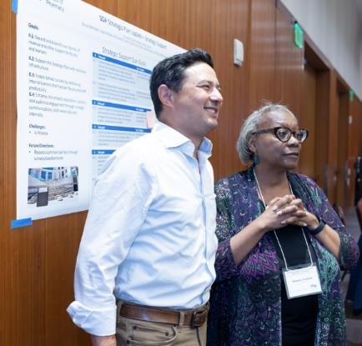
School of Pharmacy Faculty and Leadership Retreat – September 16

Slide 16

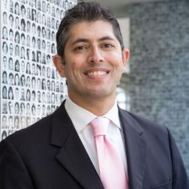
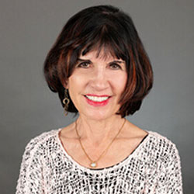
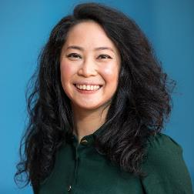
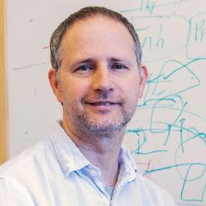
Faculty Awards
Akinyemi Oni-Orisan, PharmD, PhD
Bani Tamraz, PharmD, PhD
Kathy Giacomini, PhD, BSPharm
Inducted into American Academy of Arts & Sciences
Stephanie Hsia, PharmD, MA
Innovative Pharmacy Practice Award from the California Society of Health Systems Pharmacists
Nadav Ahituv, PhD
Scientific Achievement Award from the American Society of Human Genetics
STRIPE Double Helix Award for contributions to pharmacogenomics from the American Society of Pharmacovigilance
Notes:
Akinyemi Oni-Orisan and Bani Tamraz: STRIPE Double Helix Award for contributions to pharmacogenomics from the American Society of Pharmacovigilance
Kathy Giacomini: inducted into the American Academy of Arts & Sciences
Stephanie Hsia: Innovative Pharmacy Practice Award from the California Society of Health Systems Pharmacists
Nadav Ahituv: Scientific Achievement Award from the American Society of Human Genetics

Slide 17
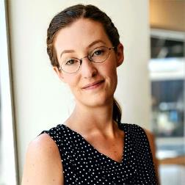
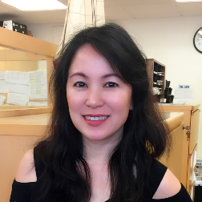
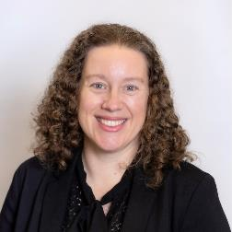
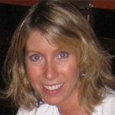
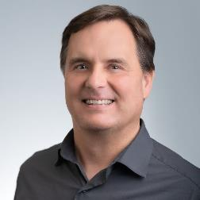


Staff SPOT Award Winners
Laura Armstrong, PhD
Assessment Analyst
Dean’s Office
Christina Chen
Post-Award Analyst
Bioengineering and Therapeutic Sciences
Lisa Duca, MBA
Executive Analyst
Clinical Pharmacy
Julie Erich
Operations Analyst
Clinical Pharmacy
Isaac Kaijankoski, MBA, MA
PSPG Program Manager
Pharmaceutical Chemistry
Notes:
Laura Armstrong, assessment analyst, Dean’s Office
Christina Chen, post-award analyst, Department of Bioengineering and Therapeutic Sciences
Lisa Duca, executive analyst, Department of Clinical Pharmacy
Julie Erich, operations analyst, Department of Clinical Pharmacy
Isaac Kaijankoski, program manager of the Pharmaceutical Sciences and Pharmacogenomics Graduate Program, Department of Pharmaceutical Chemistry

Slide 18
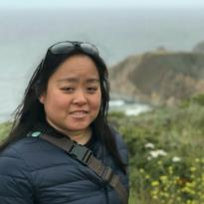
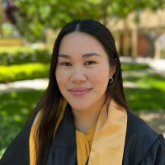
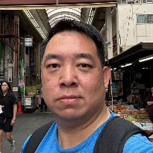
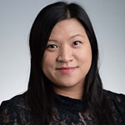
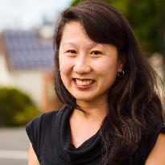
Staff SPOT Award Winners
Desiree Khu, MBA
Research Liaison
Bioengineering and Therapeutic Sciences
Thuy Le
Contracts and Grants Specialist
California Poison Control System
Peter Lu
Faculty Support Analyst
Bioengineering and Therapeutic Sciences
Ali Sasan, PhD
Financial Services Analyst
Quantitative Biosciences Institute
Jeanie Tran
Research Administrator
Clinical Pharmacy
Katherine Tam
Communications Director
Dean’s Office
Notes:
Desiree Khu, research liaison, Department of Bioengineering and Therapeutic Sciences
Thuy Le, contracts and grants specialist, California Poison Control System
Peter Lu, faculty support analyst, Department of Bioengineering and Therapeutic Sciences
Jeanie Tran, research administrator, Department of Clinical Pharmacy

Slide 19
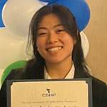
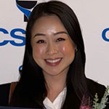
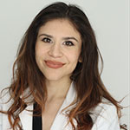
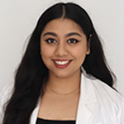
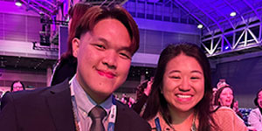
Student Awards
Elizabeth Cheung
Student Leadership Award from California Society of Health-Systems Pharmacists
Valerie Htun
Student Leadership in Health System Practice Award from California Society of Health-Systems Pharmacists
Isela Lopez
Immanuel Tjahjadi
Keo Chui
Rhea Misra
First place honors at the Student National Pharmaceutical Association’s National Clinical Skills Competition
Third place in the American Society of Health-System Pharmacists 29th Clinical Skills Competition
Notes:
Elizabeth Cheung, PharmD candidate Class of 2025: Student Leadership Award from the California Society of Health Systems Pharmacists
Valerie Htun, PharmD candidate Class of 2025: Student Leadership in Health System Practice Award from the California Society of Health-Systems Pharmacists
Isela Lopez and Rhea Misra, PharmD candidates Class of 2026: first place honors at the Student National Pharmaceutical Association’s National Clinical Skills Competition
Immanuel Tjahjadi and Keo Chui, PharmD candidates Class of 2025: third place in the ASHP 29th Clinical Skills Competition

Slide 20
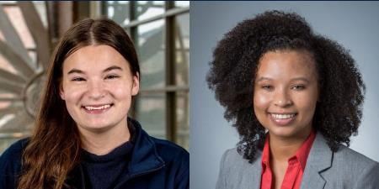
Student Awards
Maddie Blaauw
Jacqueline Williams
2025 Genentech-UCSF School of Pharmacy Diversity Fellows
Notes:
Maddie Blaauw and Jacqueline Williams: named 2025 Genentech-UCSF School of Pharmacy Diversity Fellows

Slide 21


Slide 22
School of Pharmacy Faculty & Leadership Retreat - Update
School of Pharmacy Town Hall
December 12, 2024
Sharon Youmans, Executive Vice Dean

Slide 23
School of Pharmacy
Mission
The UCSF School of Pharmacy leads in research, education, clinical care, and entrepreneurship to expand knowledge and improve the health of people everywhere.
Vision
To be the global leader in innovating pharmacy education, biomedical research, and health care.
Diversity, Equity, and Inclusion
People
Strategic Support
Transformative Partnerships
Research
Patient Care
Education
Notes:
As with all plans, we have developed draft visions and missions
And seven strategic priorities
Next slide

Slide 24
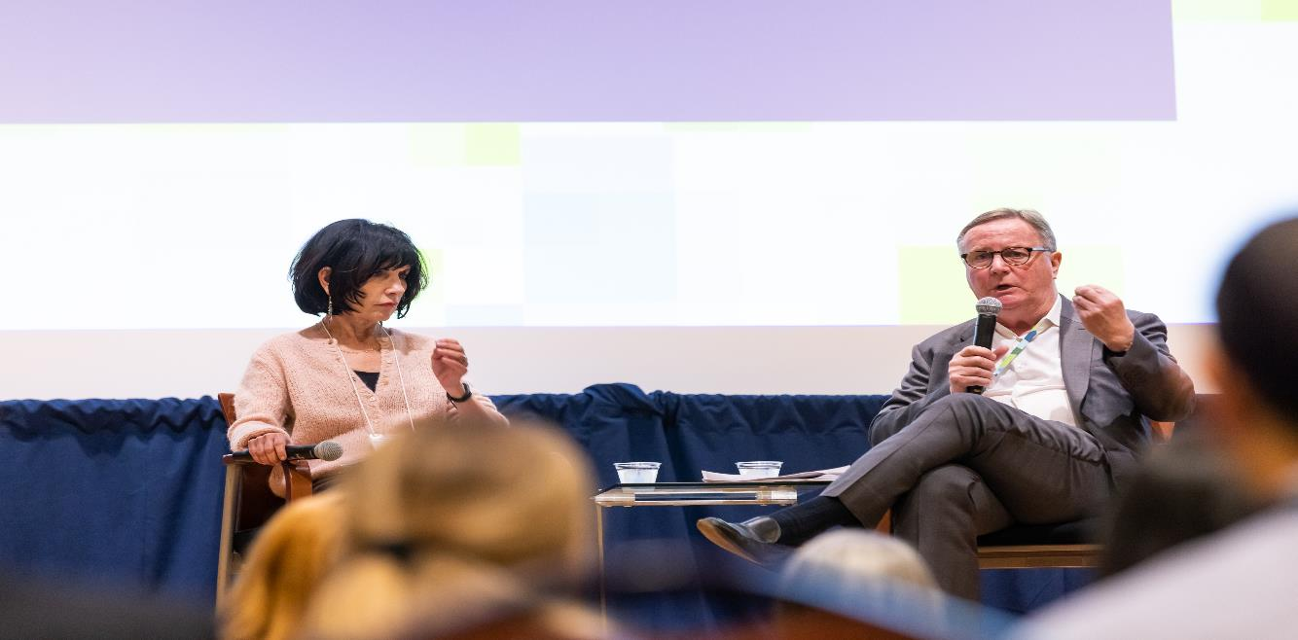
  Fireside Chat – Dean & Chancellor with Q&A

Slide 25
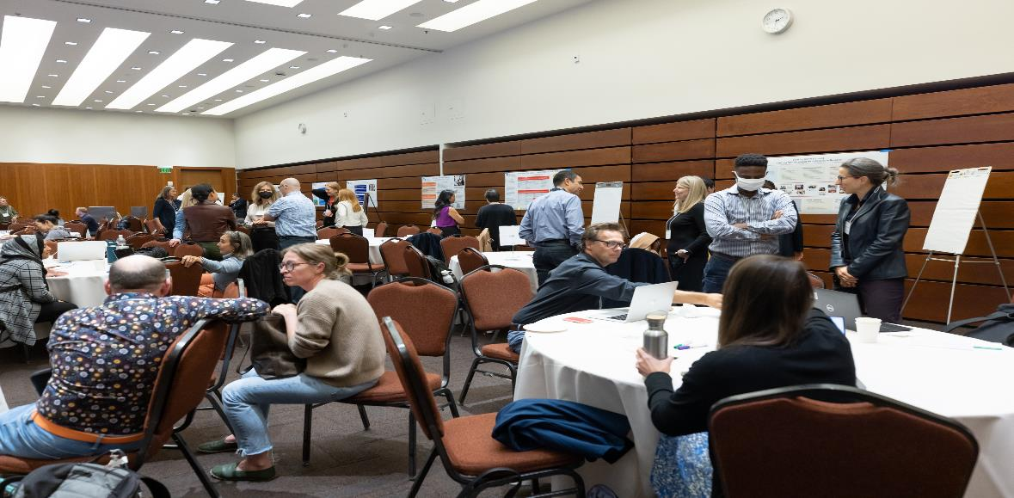
  Updates of Accomplishments from 2023-2024 – Strategic Plan Priorities with Group Discussions

Slide 26
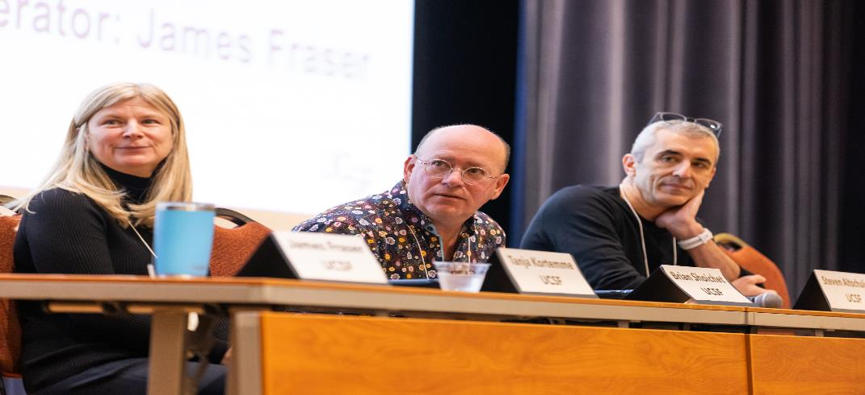
  Power Talks (5 min) – Artificial Intelligence (AI) focused on Research, Patient Care, and Education with Q&A

Slide 27
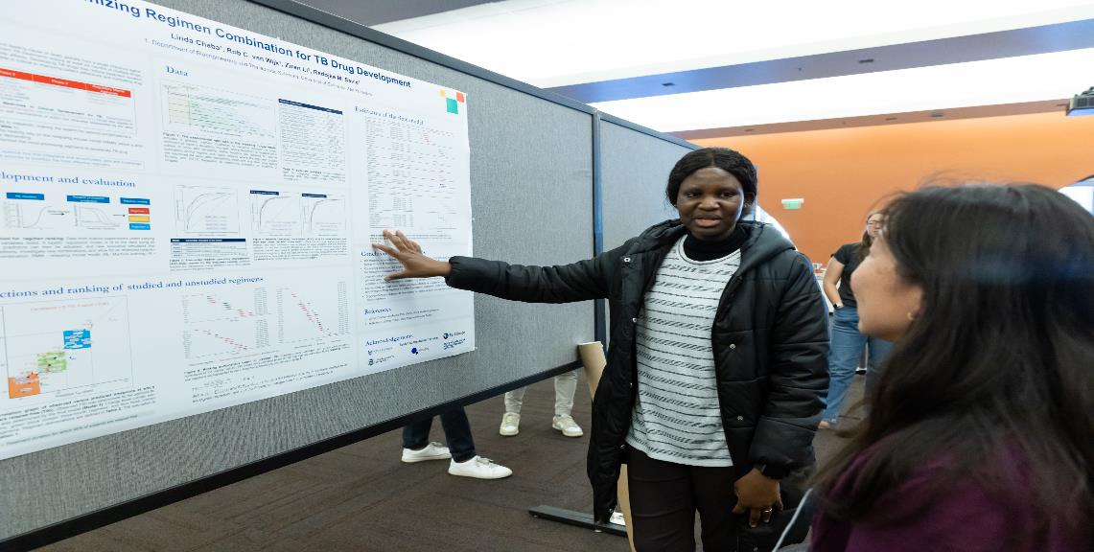
  Networking Reception and Research Posters
  with AI Themes

Slide 28
Education – Co-Leads: Conan MacDougall & Brian Shoichet
Use AI to identify gaps in learning materials (upload the material)
  Identify academic deficiencies & how to address these them based on a designed program
  Use AI to enhance teaching methods and identify best practices
Utilize AI for student assessments and provide constructive feedback on assignments
Research – Co-Leads: Robin Corelli & Tanja Kortemme
Identify long term vision for how SOP wants to move the needle on biomedical research in a transformational way. Something proactive rather than reactive.
Develop a prioritized list of research projects + connect researchers to finding opportunities

Slide 29
Patient Care – Co-Leads: Lisa Kroon & Kathy Yang
Identify patients using AI who would benefit the most from P6X testing (i.e., if you have 5+ med, 65+ etc.)
Use AI to simplify rote/routine tasks and help with answering patient questions
People/DEI – Co-Leads: Sharon Youmans & Michelle Arkin
I think it may make more sense to combine DEI and People.
Lots of mentions of work-life balance yet has that materialized in any way, shape, or form?

Slide 30
Strategic Support – Co-Leads: James Joves & Alesia Woods
Make sure progress indicators and reports are organized because accreditation focuses on strategic plan evaluation
How do we attract students to apply to UCSF pharmacy school?
Transformative Partnership – Co-Leads: Jen Cocohoba & Nevan Krogan
How can the value of some of these lesser-known partnerships be advertised to students, whom may have less interest in working with organizations they are not familiar with?
Look to build partnerships with AI industry on how to apply it to Pharmacy-related problems

Slide 31
Strategic Plan Next Steps for 2024-2025
Feedback summary on Strategic Priorities
  Co-leads to consider the feedback with the working groups
  Explore an AI suggestion for the upcoming year
  Review and or Revise current goals/subgoals
  Revise current workgroup membership
  Prepare to report out progress at the Leadership meeting in February 2025
  Set date for next Retreat – September 2025

Slide 32
Strategic Plan Information
  Strategic Plan Website
    https://pharmacy.ucsf.edu/about/strategic-plan
  SOP Retreat website
    https://pharm.ucsf.edu/retreat
Documentation and evaluation of strategic plan - for accountability and is also an accreditation requirement.

Slide 33

How can I get involved and/or
provide feedback?
QUESTIONS/COMMENTS

